Slide 1
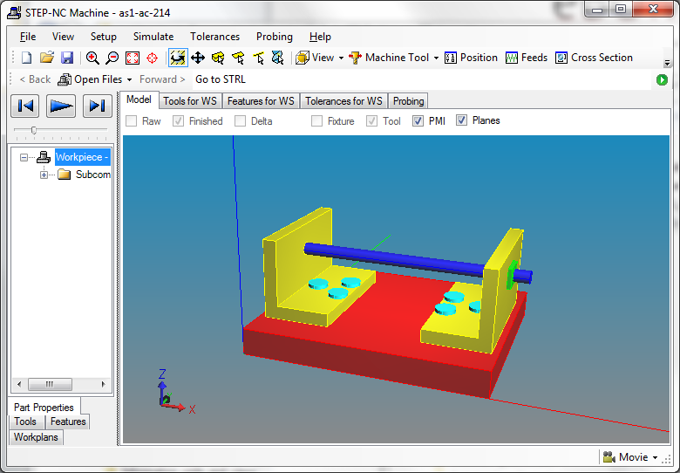
ZIP Assembly example
Two brackets on a plate each having three nuts and bolts (plus two additional nuts on the rod)

Slide 2
Part 21 form
In the P21 form there is only one instance of the nut/bolt assembly
This instance is implicitly referenced 6 times but explicitly referenced only three times
All nut and bolts have to have the same properties (such as color)
As1_pe
Left
Right
bracket
There are five placement transformations (left, right, top, middle & bottom)
Top
Middle
Bottom
nut/bolt assembly

Slide 3
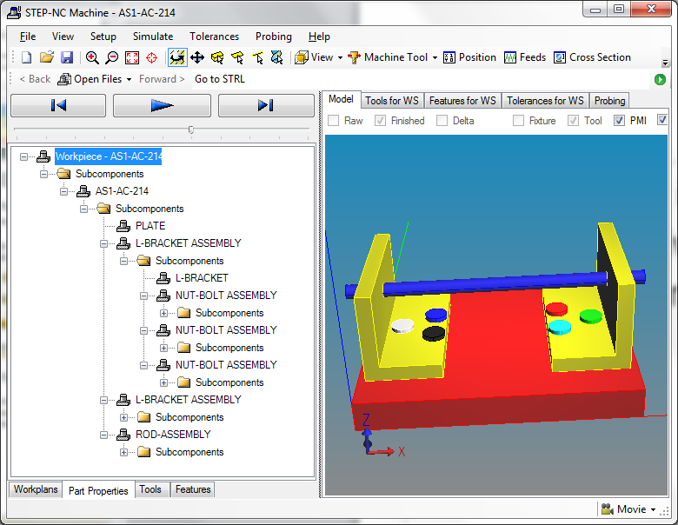
ZIP Assembly form
The different instances have different colors and can be given other instance unique information such as dimensions and tolerances

Slide 4
ZIP Assembly form
Because there are different instances we can annotate different colors onto each instance
As1_pe
Left
Right
bracket
bracket
Top
Middle
Bottom
Top
Middle
Bottom
nut/bolt
assembly
nut/bolt
assembly
nut/bolt
assembly
nut/bolt
assembly
nut/bolt
assembly
nut/bolt
assembly
Colors
red
white
blue
green
white
orange
There are 8 placement transformations (L, R, LT, LM, LB, RT, RM, RB)

Slide 5
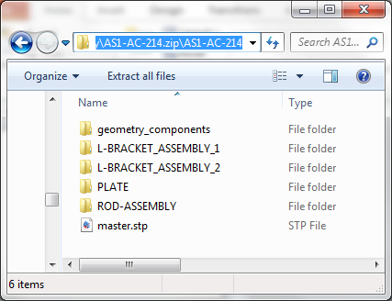
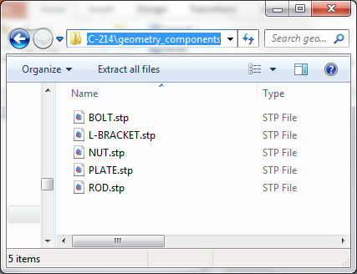
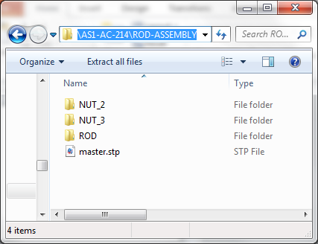
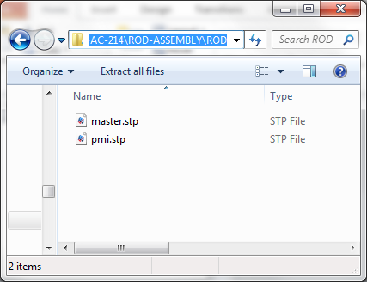
ZIP Assembly details
We do not duplicate geometry
root
geometry
Sub- assembly
leaf

Slide 6
Key for ZIP Assembly
Each sub-assembly becomes a directory
The name of that sub-assembly directory is the NAUO for that sub-assembly
Each directory has a file called master.stp that describes how to convert that directory to a STEP file
Leaf directories (see ROD on previous page) contain a master.stp and a pmi.stp describing the pmi that applies to that instance
The master.stp in the leaf directories reference shared geometry in the geometry_components directory

Slide 7
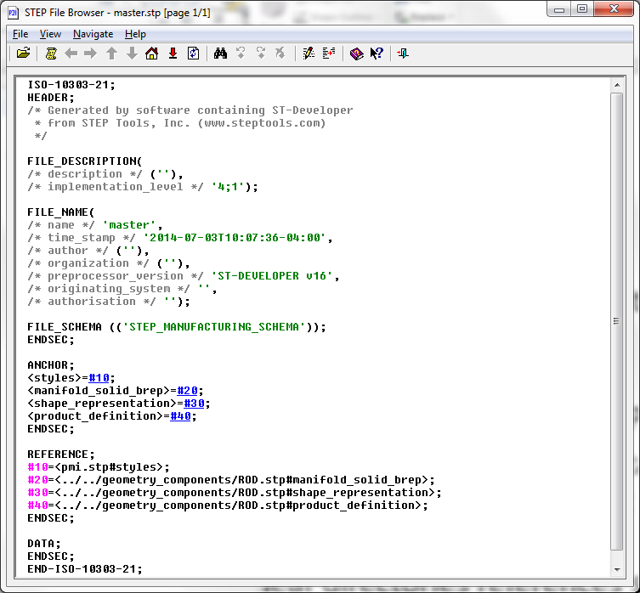
ROD/master.stp
#10 references the styles file
in the same directory
#20 references the manifold of the rod so it can be colored
#30 references the shape of the rod so it can be placed
#40 references the definition of the rod so it can be assembled

Slide 8
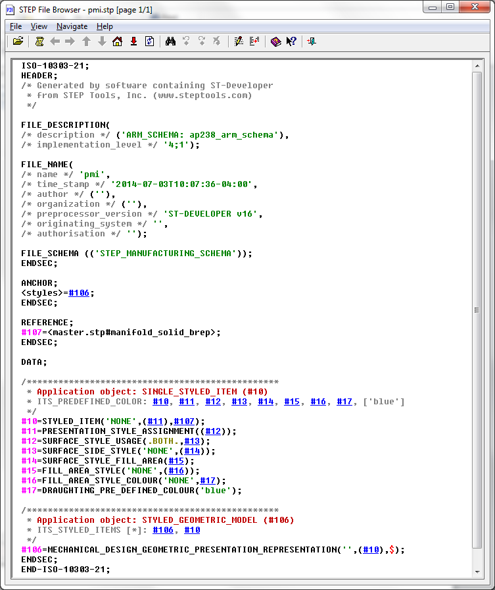
ROD/pmi.stp
#107 applies the color to the product in the master of this directory (which is the rod)

Slide 9
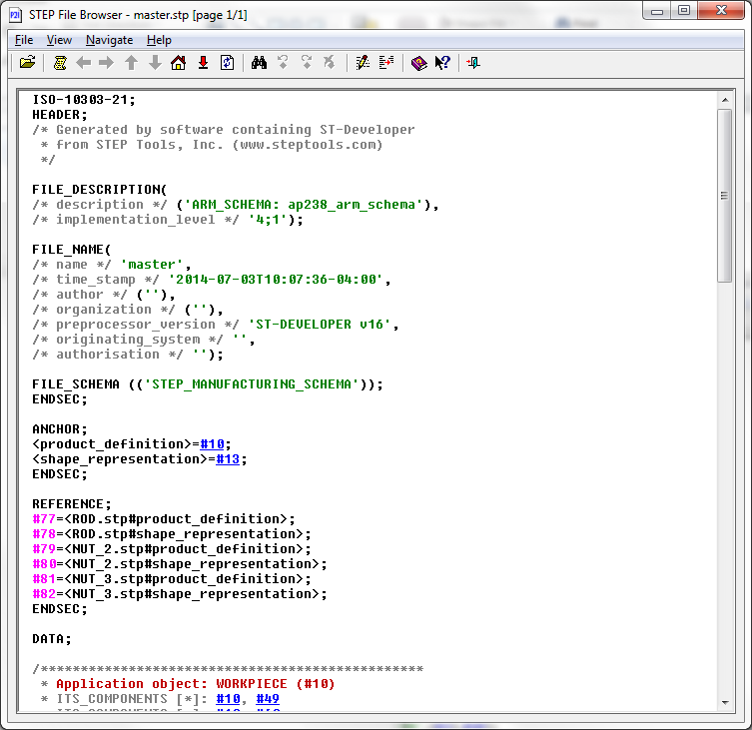
ROD_ASSEMBLY/master.stp
Two anchors define how to use this assembly in higher assemblies
Six references define how to find the three components needed for the ROD_ASSEMBLY

Slide 10
Algorithm to convert a directory to a STEP Part 21 file
For each directory an equivalent STEP file can be computed as follows
Read master.stp for the directory
Read all files referenced directly or indirectly by master.stp and merge them into master.stp
Resolve reference/anchors pairs for the merged file
If there are any unresolved references report error
Delete any anchors not in the original master.stp
Replace the directory with the new STEP file

Slide 11
Advantages of the ZIP organization
Can define PMI for individual instances without duplicating geometry
Can define many different organizations for each directory
Can replace one organization with another without impacting external applications
Clear distinction between internal details and external interfaces as defined by master.stp

