Slide 1
AP238 E4 – Model Based Manufacturing
Q1&2 2023
Q3&4 2023
Q1&2 2024
Q3&4 2024
Q1&2 2025
Q3&4 2025
CD
CIB
demo
Pub
Drill & Fill
W Draft
demo planning
DIS
Ballot
improve content
DIS
reg
improve content
document content
AM PBF
W Draft
demo planning
demo
improve content
DIS
reg
improve content
document content
Composites
W Draft
demo planning
demo
improve content
DIS
reg
improve content
document content
improve content
Machining
W Draft
demo planning
demo
improve content
DIS
reg
improve content
document content
Drill & Fill
Model based assembly to reduce weight
W Draft
EXPRESS definition of requirements
AM PBF
Additive and subtractive for shape management
CIB
Ballot
Mapping tables
Composites
Accurate tape layup at reduced cost
DIS
reg
English descriptions (final form)
Machining
Reduce tool wear and cycle time

Slide 2
Strengths and challenges
Team | Foundations | Strengths | Challenges
Powder bed fusion | Team expertise ISO 14649-17
Advanced machining | Team expertise 20 years of software
Composite tape layup | Team expertise AP242 rich in composites
Drill and Fill for assemblies | Team expertise 10 years of software

Slide 3
Why, What and How
Team | Why this standard | What are the barriers | How to show solution
Powder bed fusion
Advanced machining
Composite tape layup
Drill and Fill for assemblies

Slide 4
Prepare for next time
Teams administrative questions
Please Prepare
Planned demonstration scope
Team members, key names
Projected start and end dates
Necessary conditions for start
How WG15 and SC4 can help
Slide #1 summarize your demo
Slide #2 answer the challenges
Slide #3 address why, what, how
Slide #4 administrative questions

Slide 5
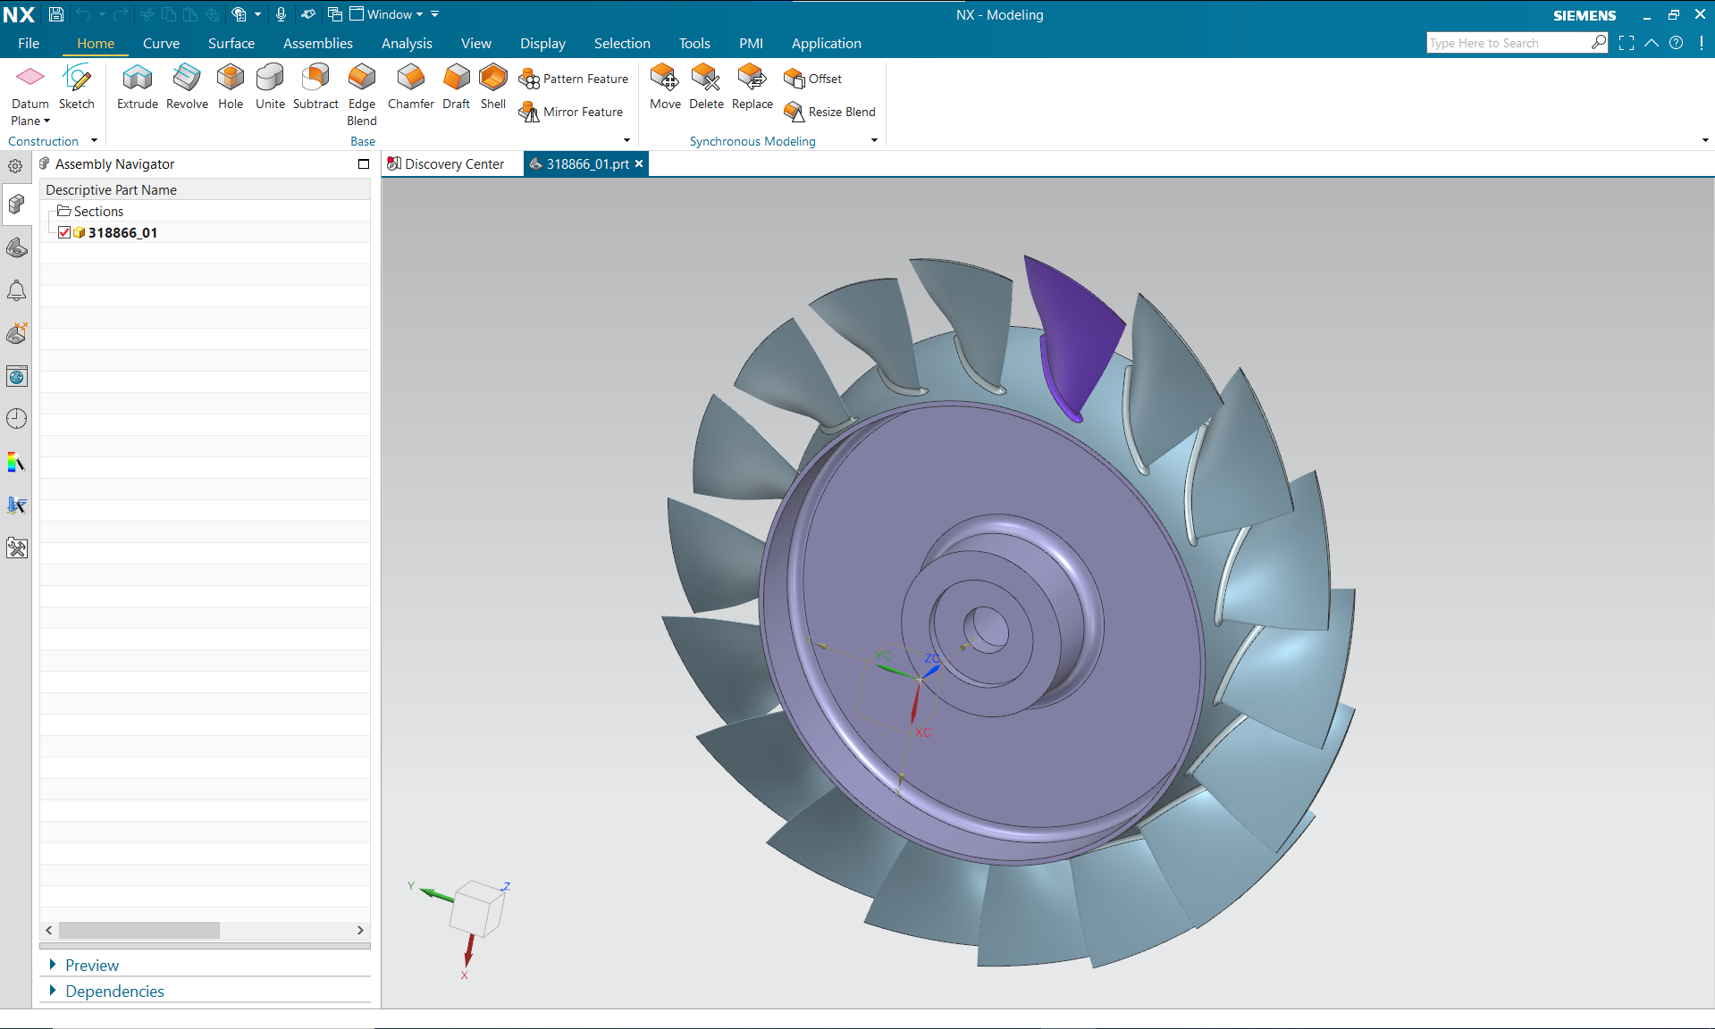
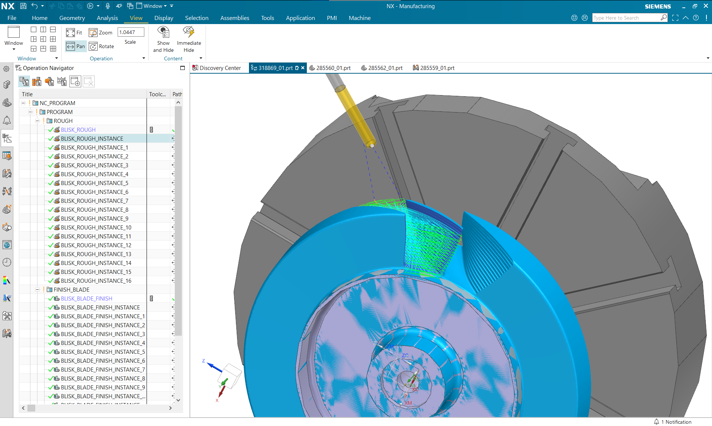
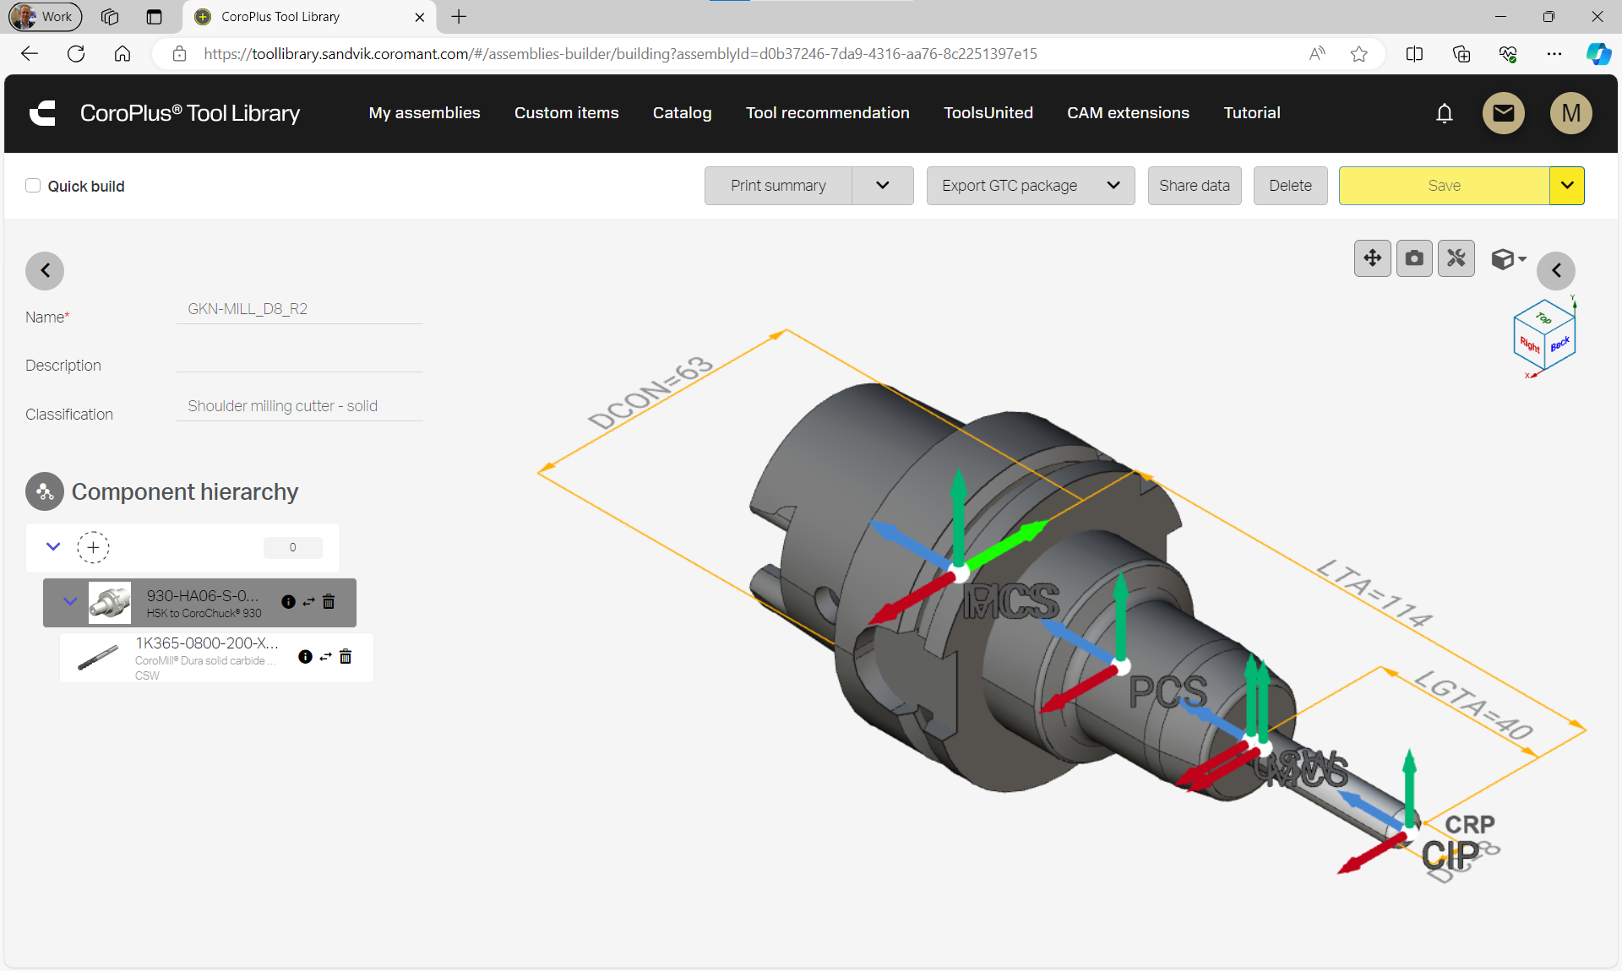
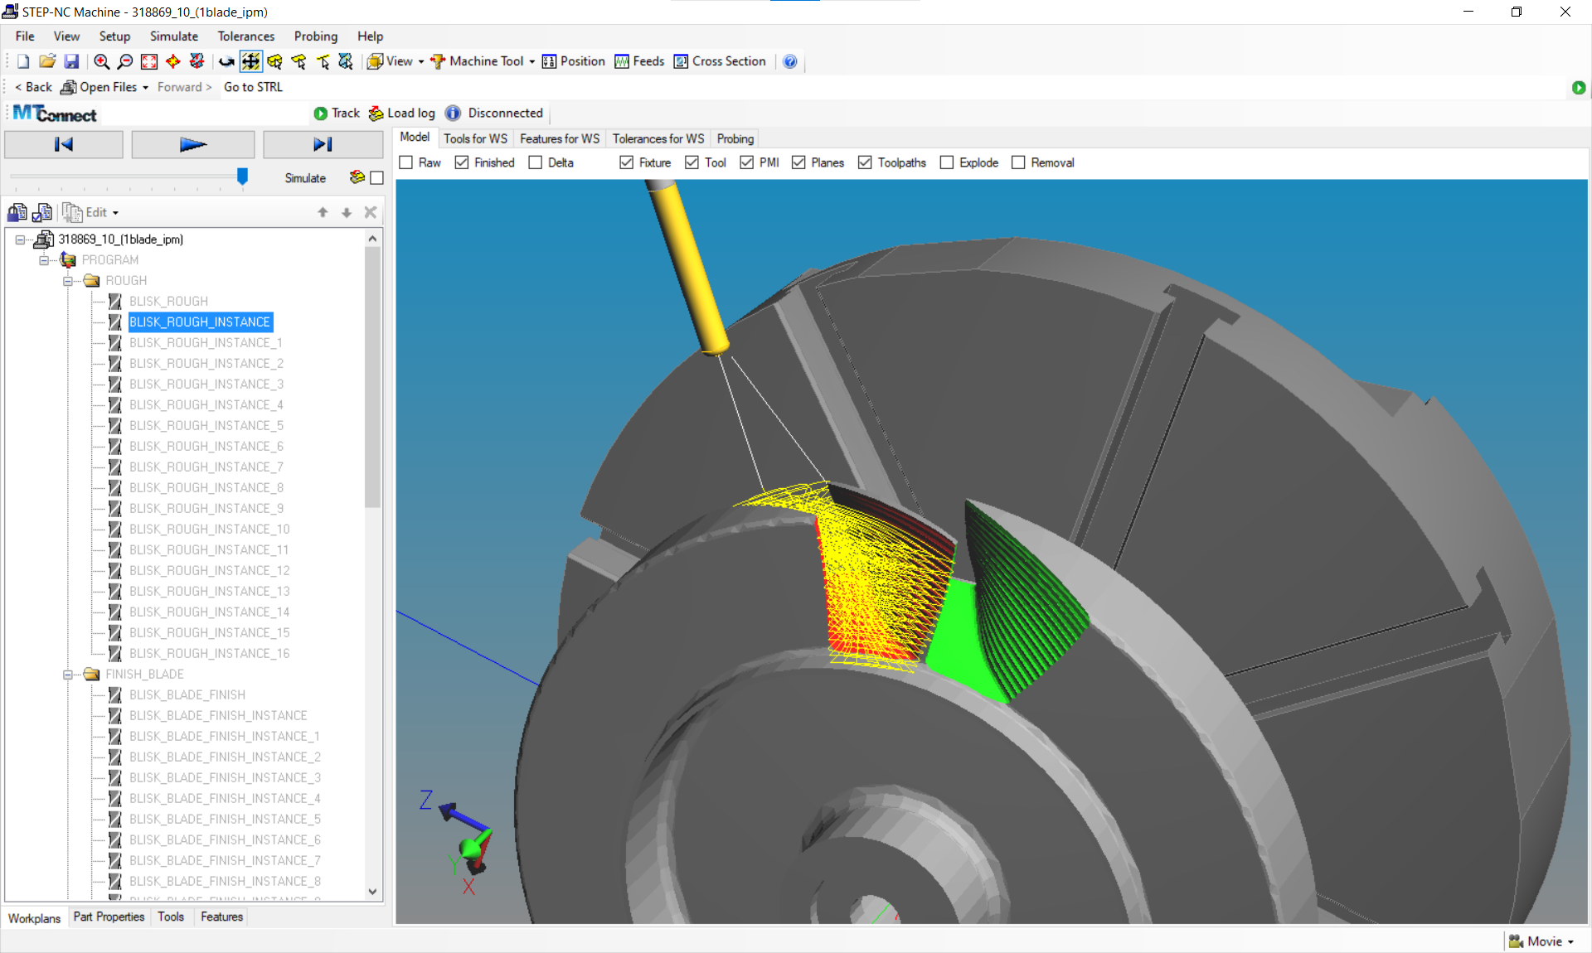
AP238 ed4 DIS demo proposal
EXAMPLE OF #1
Machining system constraints (torque, power, accelerations, jerk, stiffness etc.)
Problem situation
Tool wear
Cycle time
Implementation
Adaption
Comparison
Collaborative process planning
STEP AP242
STEP-NC AP238
Analysis of
Chip thickness
Tool life prediction
Change proposal
Cutting process
Tool assembly
2024-06-14

Slide 6
Conclusion – time budget for the yellow?
Q1&2 2023
Q3&4 2024
Q3&4 202?
Q3&4 2023
Q1&2 2024
Q1&2 2025
CD
CIB
demo
Pub
W Draft
demo planning
DIS
Ballot
DIS
reg
Drill & Fill
document content
improve content
improve content
W Draft
demo planning
demo
DIS
reg
AM PBF
document content
improve content
improve content
Composites
W Draft
demo planning
demo
improve content
improve content
document content
improve content
DIS
reg
Machining
W Draft
demo planning
demo
improve content
improve content
document content
DIS
reg
Drill & Fill
Model based assembly to reduce weight
W Draft
EXPRESS definition of requirements
AM PBF
Additive and subtractive for shape management
CIB
Ballot
Mapping tables
Composites
Accurate tape layup at reduced cost
DIS
reg
English descriptions (final form)
Machining
Reduced tool wear and cycle time
TBD?
Time extension for Inter-laboratory testing

