Slide 1
Digital Twin term visualization
Submitted by Richard Martin 8-13-2022
Revised 8-25-2022 per meeting discussion
Revised 9-07-2022 per meeting discussion
Revised 9-20-2022 per meeting discussion
Revised 10-05-2022 per meeting discussion
Revised 10-19-2022 per meeting discussion

Slide 2
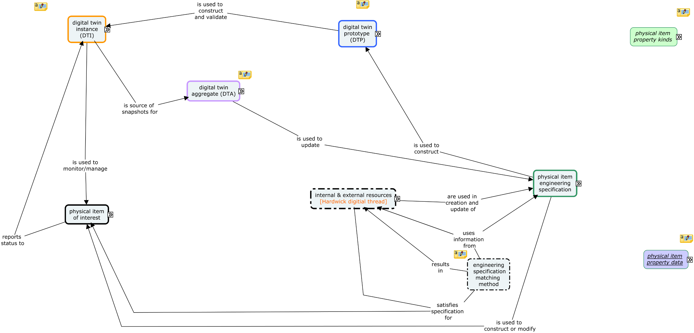

Slide 3
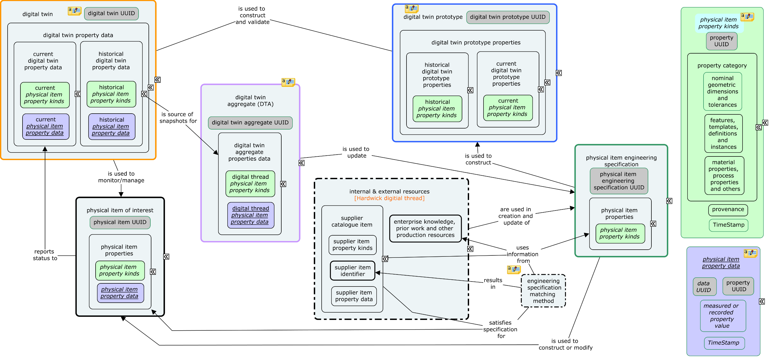
Consider the ‘thread’ analogy and the way ‘threads’ are used in analogic reasoning. The basis for the analogy lies in the historical use of fibers to construct material for different purposes – primarily as cloth. Threads in a cloth fabric are used in the warp, which provides the foundation for the fabric, and the welt, which is the running thread ‘woven’ across the warp. Above we can envisage the left panel as the welt woven into the warp foundation in the middle panel and the right panel as ‘colors’ common to the foundation and running weave bond.

Slide 4
In the figure on the previous slide, the object labelled ‘internal & external resources’ is annotated as ‘Hardwick digital thread’ to recognize one of several definitions for ‘digital thread’ offered by participants. (This annotation may not properly express Martin’s thoughts about the digital thread.) Thurman and others expressed a definition that has the concept of digital thread representing the communications among the stated objects, which makes the ‘digital thread’ more process oriented than data oriented where Martin’s characterization is more data oriented.
Reviewing the many definitions now available for the term ‘digital thread’ leads to a recognition of the importance of data and process to the concept of digital thread – something akin to the warp, welt and process of weaving from conception of the ‘system of interest’ through its entire life time.
Such a recognition then places all of the stated objects, their interrelationships, and the processes by which they are created and managed into the category of ‘digital thread’. This huge category is then utilized for specific purposes by articulating use cases, which are akin to fabric requirements and designs, completing the ‘threads analogy’.

Slide 5
Possible depiction of digital thread as a communication channel for digital information
Design engineering
sub-channel
DTI-EoI sub-channel
Acquisition
engineering
sub-channel
EoI production
sub-channel
Production engineering
sub-channel
DTI configuration
sub-channel
DTI utilization
sub-channel
Refer to slide 3 for entity details.
Continuing the analogy – the depicted sub-channels are strands of the various digital threads of the warp and welt of the digital fabric.

