Slide 1
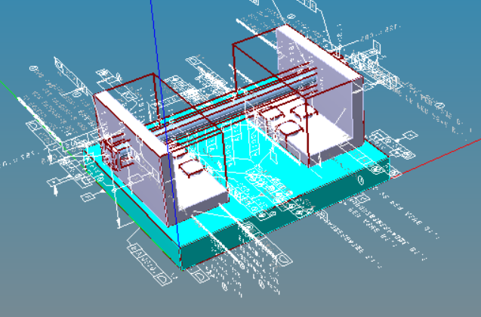
UUID for Digital Twins and the Digital Thread
Martin Hardwick
AS1 Prototype

Slide 2
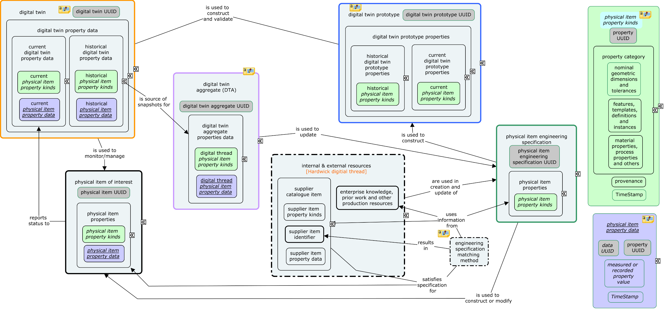
Consider the ‘thread’ analogy and the way ‘threads’ are used in analogic reasoning. The basis for the analogy lies in the historical use of fibers to construct material for different purposes – primarily as cloth. Threads in a cloth fabric are used in the warp, which provides the foundation for the fabric, and the welt, which is the running thread ‘woven’ across the warp. Above we can envisage the left panel as the welt woven into the warp foundation in the middle panel and the right panel as ‘colors’ common to the foundation and running weave bond.

Slide 3
Types of UUID
Thread UUID for a requirement (enterprise & contract stuff)
UUID for a grip length, UUID for a L-bracket
UUID for a weight requirement, UUID for a SysML requirement
Definition UUID for a prototype (CAD and CAM stuff)
UUID for a product definition, UUID for a feature definition
UUID for a dimension definition, UUID for a parameter definition
Twin UUID for an instance (manufacturing and maintenance stuff)
UUID on a product instance, UUID on a feature instance
UUID on a dimension instance, UUID on a parameter instance

