Slide 1
Digital Twin term visualization
Submitted by Richard Martin 8-13-2022
Revised 8-25-2022 per meeting discussion
Revised 9-07-2022 per meeting discussion
Revised 9-20-2022 per meeting discussion
Revised 10-05-2022 per meeting discussion

Slide 2
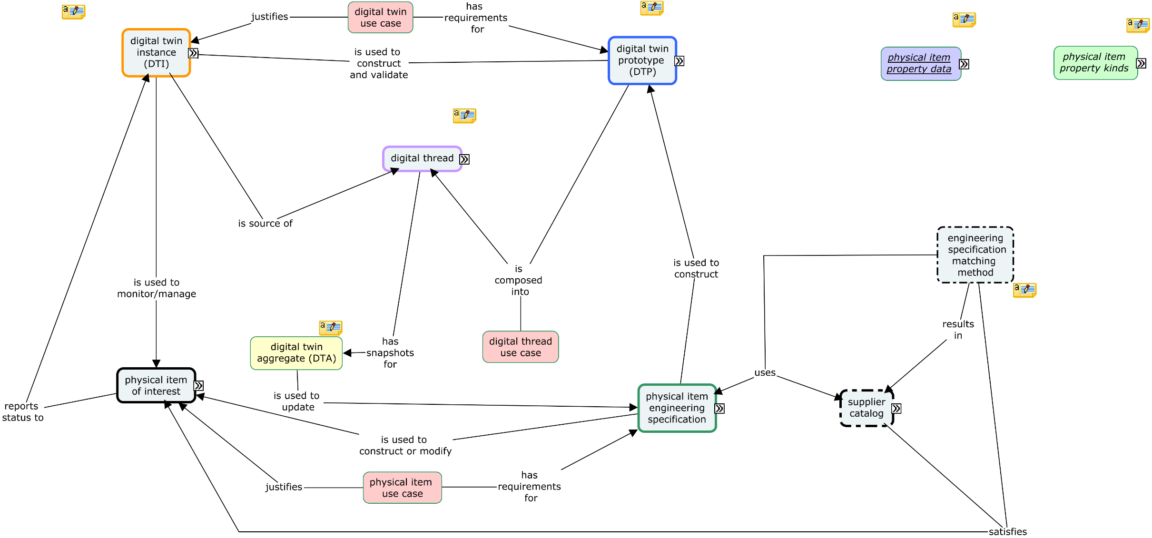

Slide 3
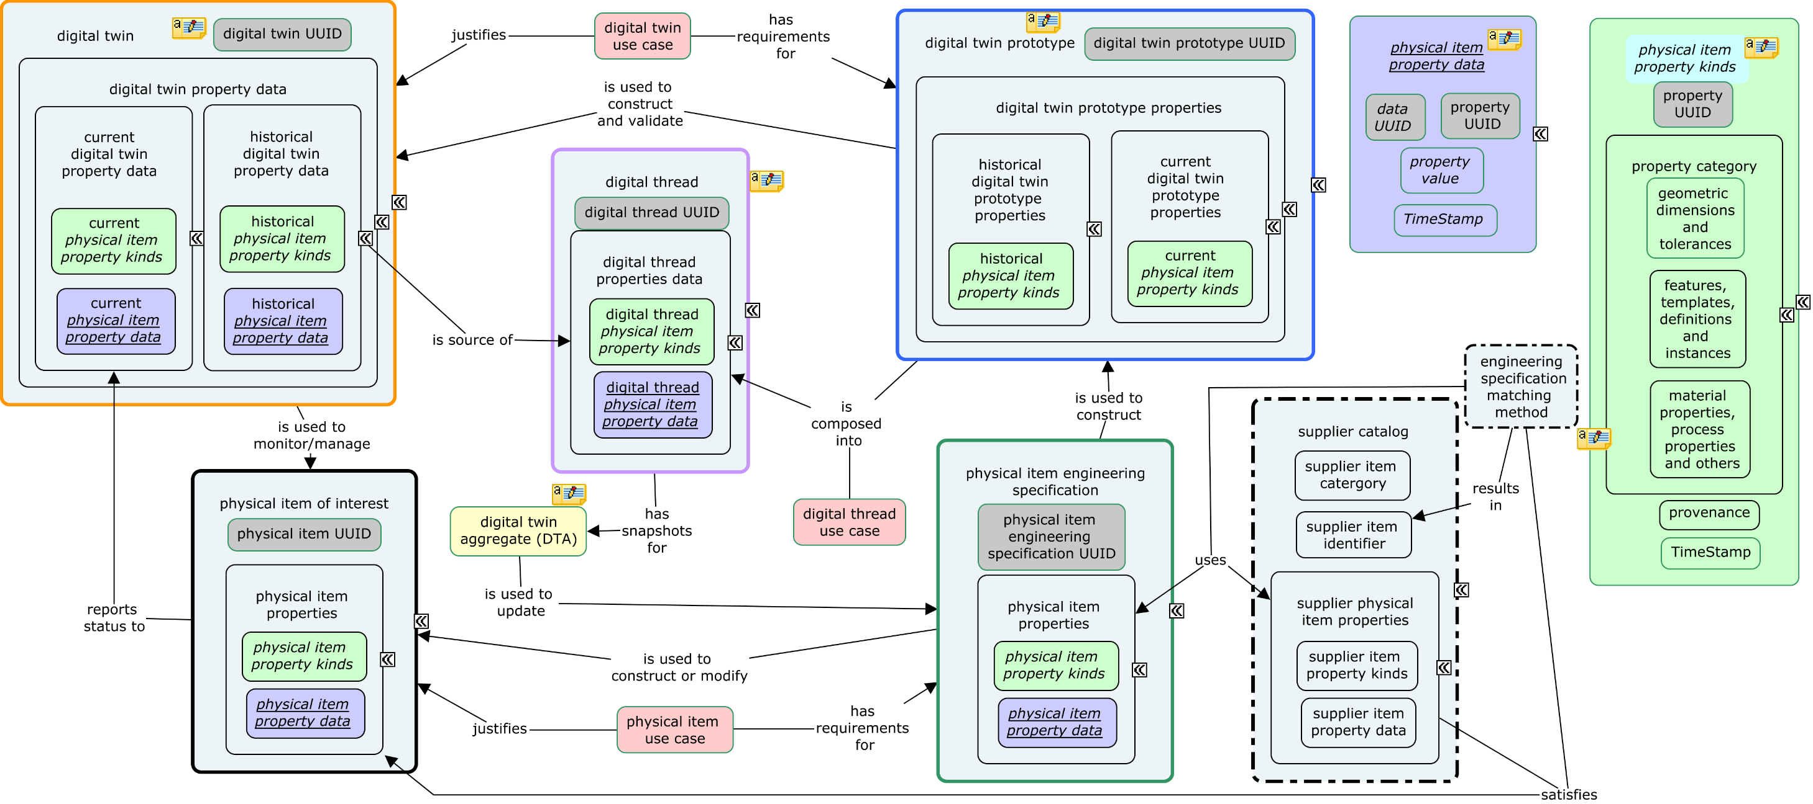

Slide 4
physical item property kinds:
property UUID
property category:
geometric dimensions and tolerances
features, templates, definitions and instances
material properties, process properties and other
provenance
timestamp
---------------------------------------------------------------------------------------------------------------
physical item use case:
justification
requirements
Physical item use case justifies physical item of interest.
Physical item use case has requirements for physical item engineering specification.
---------------------------------------------------------------------------------------------------------------
physical item of interest:
physical item UUID
physical item properties:
physical item property kinds
physical item property data
Physical item of interest reports status to digital twin.
---------------------------------------------------------------------------------------------------------------
physical item engineering specification:
physical item engineering specification UUID
physical item properties:
physical item properties:
physical item property kinds
physical item property data
Physical item engineering specification is used to construct or modify physical item of interest.
Physical item engineering specification is used to construct digital twin prototype.
---------------------------------------------------------------------------------------------------------------
physical item property data:
property UUID
data UUID
property value
timestamp
-------------------------------------------------------------------------------------------------------------------------
digital twin:
digital twin UUID
digital twin property data:
current digital twin property data:
current physical item property kinds
current physical item property data
historical digital twin property data:
historical physical item property kinds
historical physical item property data
Digital twin is used to manage/monitor physical item of interest.
Digital twin: digital twin property data: historical digital twin property data is source of digital thread: digital thread properties data.
-------------------------------------------------------------------------------------------------------------------------
digital twin prototype
digital twin prototype UUID
digital twin prototype properties
current digital twin prototype properties:
current physical item property kinds
historical digital twin prototype properties:
historical physical item property kinds
Digital twin prototype is used to construct and validate digital twin.
Digital twin prototype is composed into digital thread: digital thread properties data: digital thread physical item property kinds.
--------------------------------------------------------------------------------------------------------------------------
-

Slide 5
digital thread
digital thread UUID
digital thread properties data:
physical item property kinds
physical item property data
Digital thread has snapshots for digital twin aggregate.
---------------------------------------------------------------------------------------------------------------------------
digital twin aggregate
Digital twin aggregate is used to update physical item engineering specification.
---------------------------------------------------------------------------------------------------------------------------
digital twin use case
justification
requirements
Digital twin use case justifies digital twin.
Digital twin use case has requirements for digital twin prototype.
---------------------------------------------------------------------------------------------------------------------------
digital thread use case
justification
requirements
Digital thread use case is composed into digital thread: digital thread properties data: digital thread physical item property kinds.
---------------------------------------------------------------------------------------------------------------------------
supplier catalogue
supplier item category
supplier item identifier
supplier physical item properties
supplier item property kinds
supplier item property data
Supplier physical item properties satisfies physical item of interest physical item properties.
------------------------------------------------------------------------------------------------------------------------------
engineering specification matching method
Engineering specification matching method uses physical item of interest physical item properties.
Engineering specification matching method uses supplier catalogue supplier physical item properties
Engineering specification matching method results in supplier catalogue supplier item identifier.
Engineering specification matching method satisfies physical item of interest physical item properties.

