Slide 1
Digital Twin term visualization
Submitted by Richard Martin 8-13-2022
Revised 8-25-2022 per meeting discussion

Slide 2
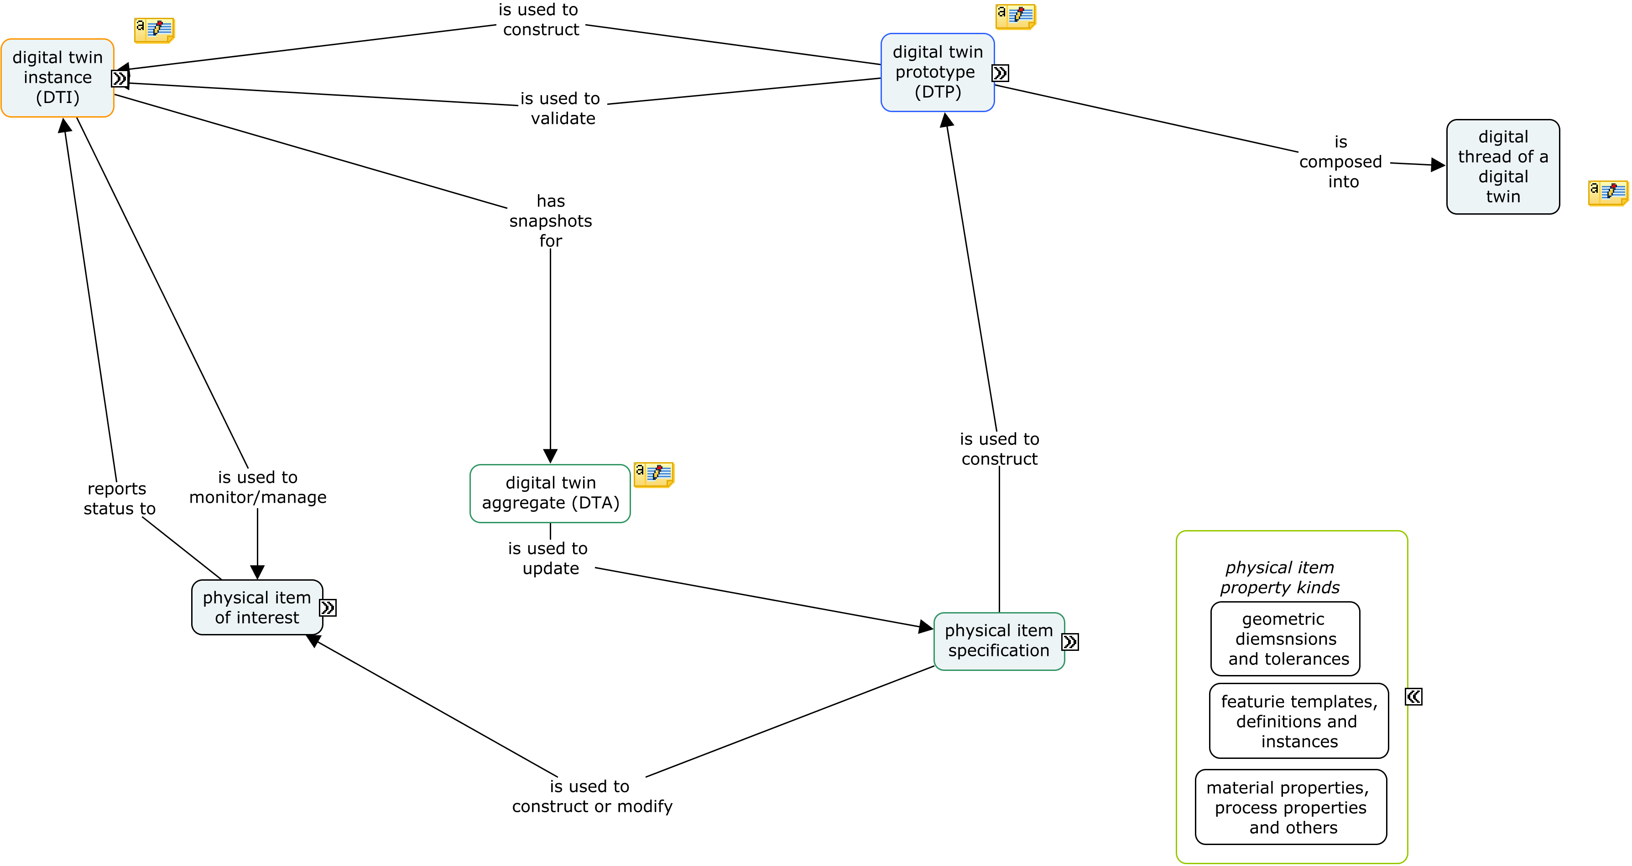

Slide 3
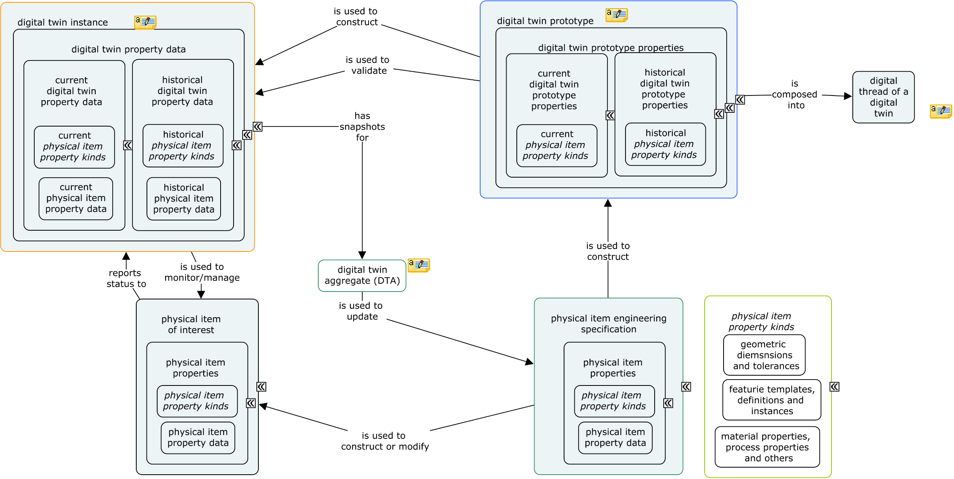

Slide 4
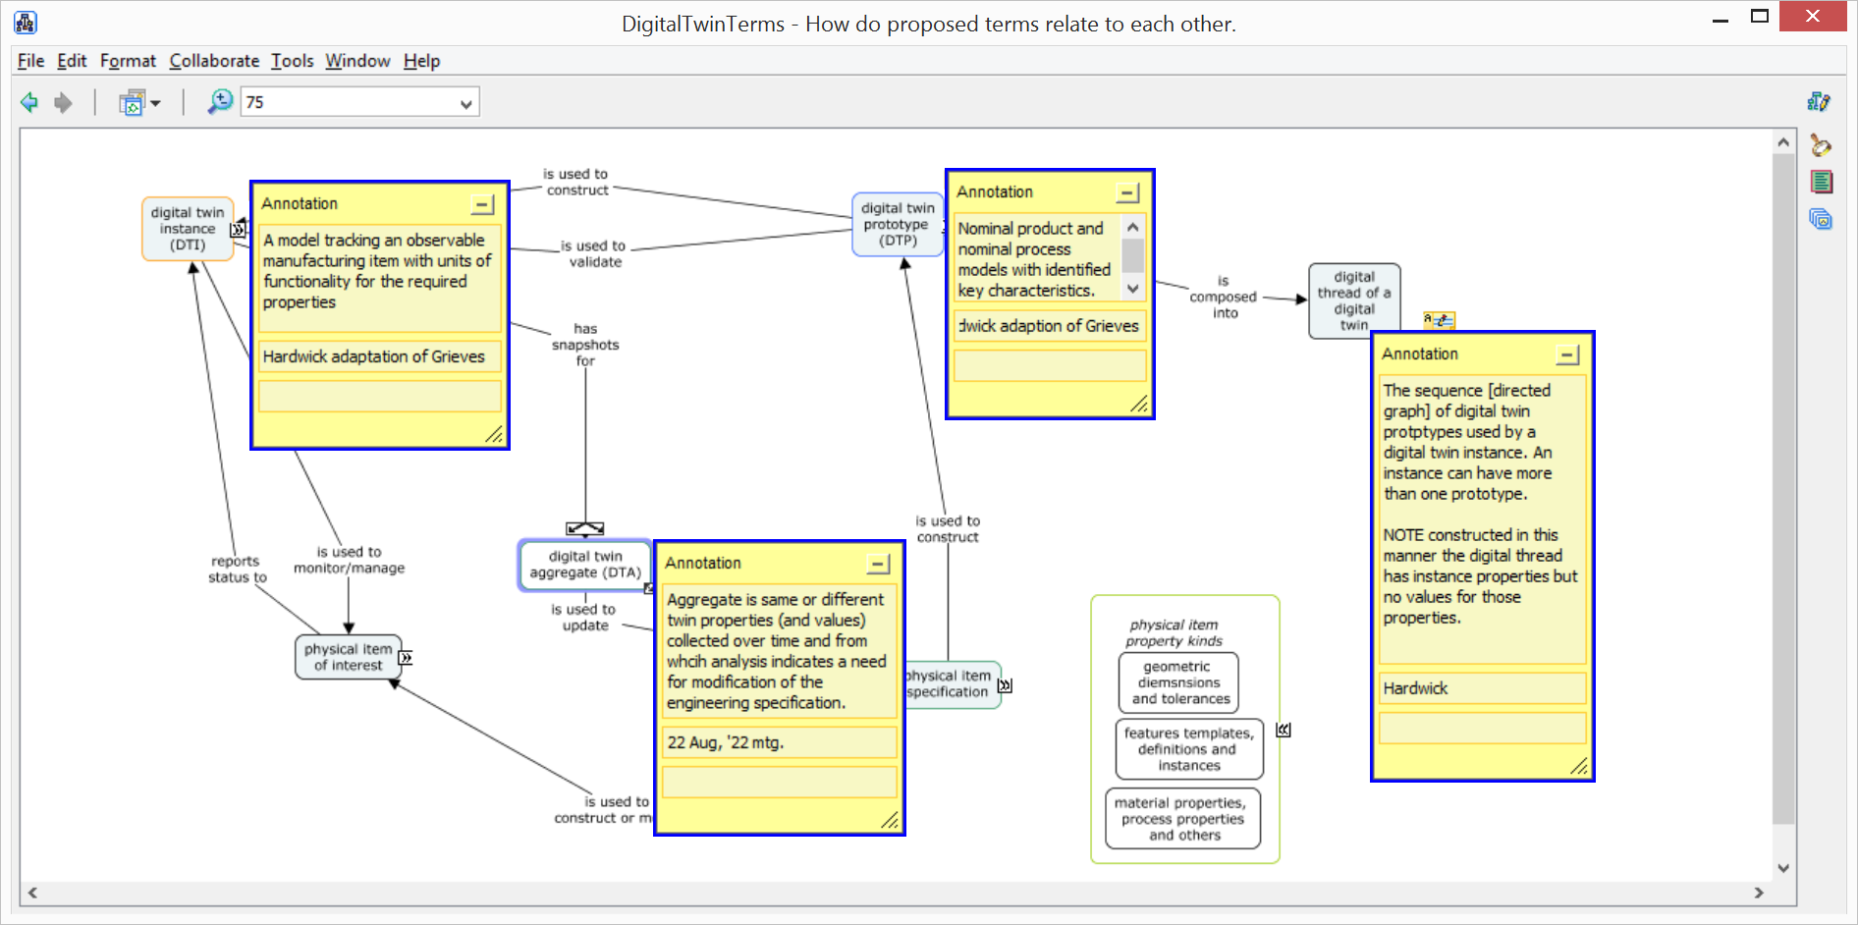

Slide 5
physical item engineering specification
physical item properties
physical item property kinds
physical item property data
physical item engineering specification is used to construct digital twin prototype (DTP)
physical item engineering specification is used to construct or modify physical item of interest
--------------------------------------------------------------------------------------------------
physical item of interest
physical item properties
physical item property kinds
physical item property data
physical item of interest reports status to digital twin instance (DTI)
--------------------------------------------------------------------------------------------------
digital twin prototype
digital twin prototype properties
current digital twin prototype properties
current physical item property kinds
historical digital twin prototype properties
historical physical item property kinds
digital twin prototype (DTP) is used to construct digital twin instance (DTI)
digital twin prototype (DTP) is used to validate digital twin instance (DTI)
digital twin prototype (DTP) is composed into digital thread of a digital twin
digital twin instance
digital twin property data
current digital twin property data
current physical item property kinds
current physical item property data
historical digital twin property data
historical physical item property kinds
historical digital twin property data
digital twin instance (DTI) is used to monitor/manage physical item of interest
digital twin instance (DTI) has snapshots for digital twin aggregate (DTA)
--------------------------------------------------------------------------------------------------
digital twin aggregate
digital twin aggregate (DTA) is used to update physical item engineering specification
--------------------------------------------------------------------------------------------------
digital thread of a digital twin
--------------------------------------------------------------------------------------------------
physical item property kinds
geometric diemsnsions and tolerances
features templates, definitions and instances
material properties, process properties and others

