Slide 1
ISO 23247 Digital Twin
Use case Testing
Scope reductions to enable August 25 completion
Results of June 23 Conference call

Slide 2













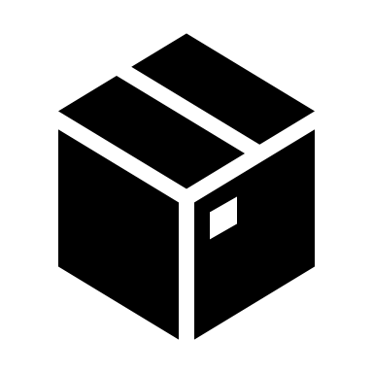
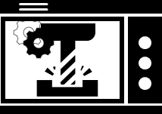
ISO 23247-4 Figure A.1
PLM
UI
MES
ERP
Other
Data Sources
Other
Twin
Super-visor
User entity
Web Client
Service network
User network
Web Server
Open API, administration shell
cloud
Core entity
Operation & management
sub-entity
Application & service
sub-entity
Resource access & interchange
sub-entity
MTConnect client, UMATI client, ISA-88 client, …
Access network
Legacy communication channel
Access network
DCDCE: Data collection and device control entity
OME: Observable manufacturing element
(solid line): within scope of Digital Twin
(dotted line): out of scope of Digital Twin
Italic: Example protocol/implementation
MTConnect agent, UMATI agent, ISA-88 state machine …
Access network
DCDCE
(data collect only)
Adaptation, protocol translation
MTConnect agent, UMATI agent, ISA-88 state machine …
Proximity network
EtherCAT, OPC-UA,
Profinet, Modbus, …
DCDCE
OME
OME

Slide 3
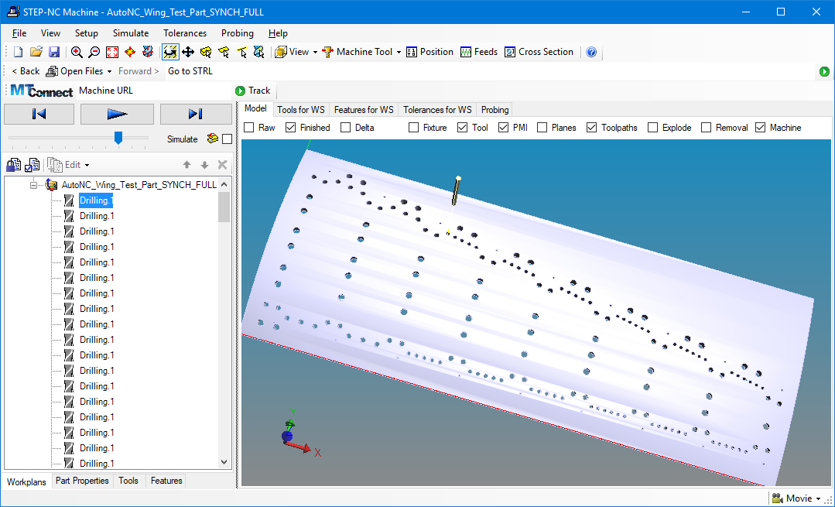
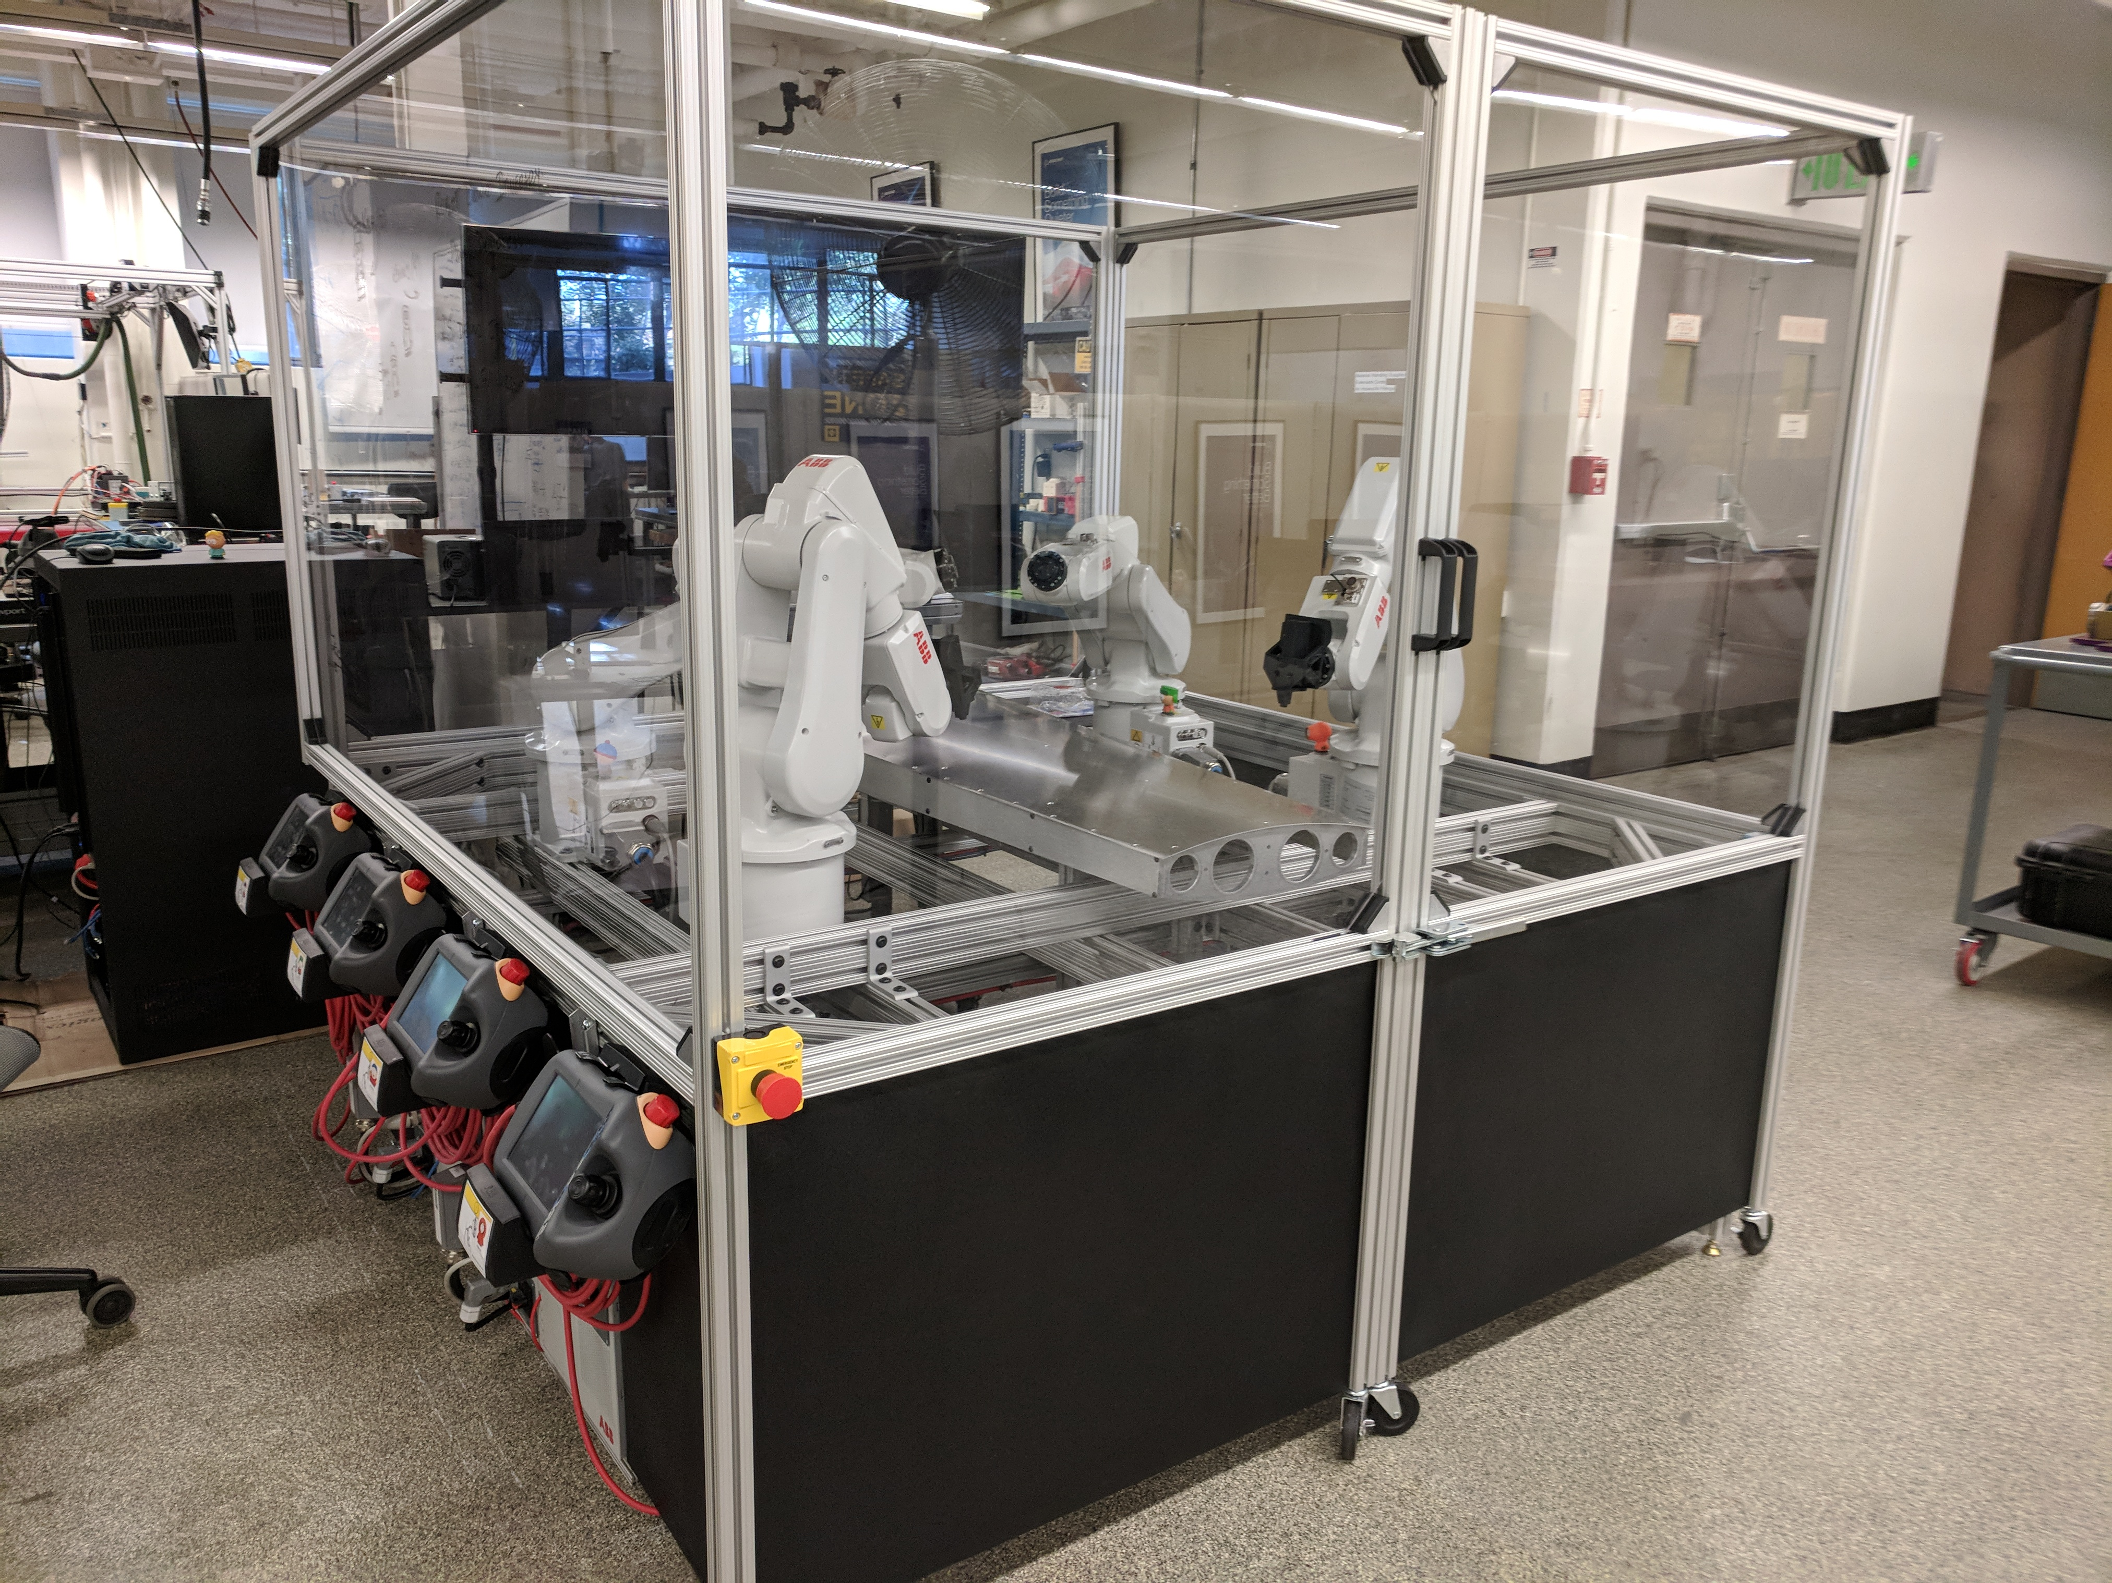
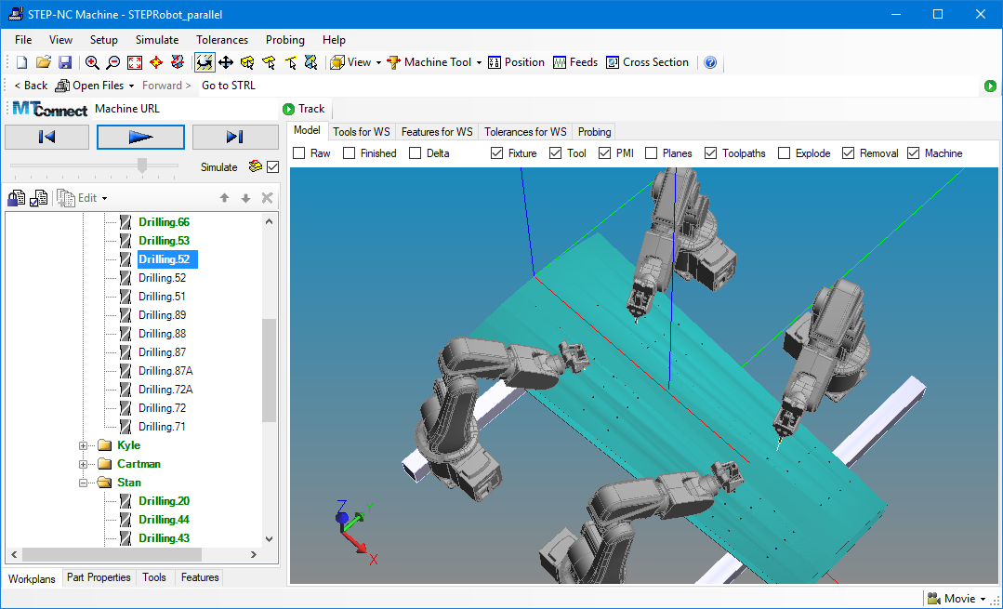
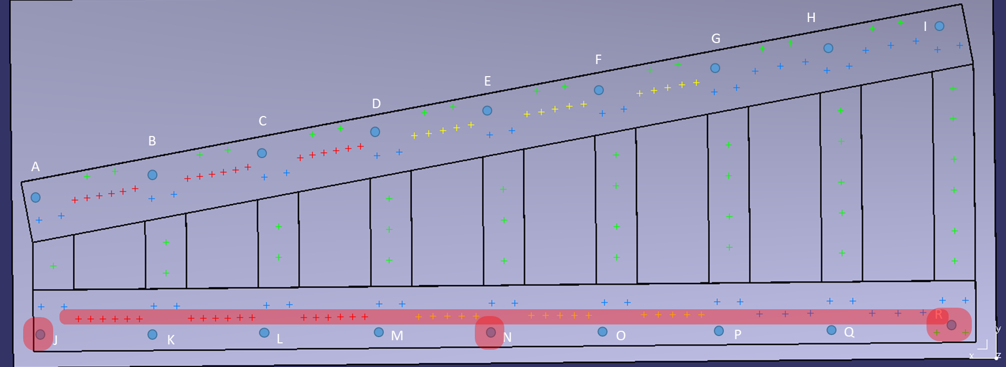
Use Case 1 – flexible schedule for robot drill & fill
On-shoring can increase by 50%

Slide 4


User entity
PLM/ERP
MOM
AP238
AP242
Supervisory Control
Coordinator
State
Machine
(supervisory)
Combiner
MTConnect
AP238
AP242
Adjust schedule for
Completed ops
Unwanted ops
Unavailable robots
Core entity
Process Digital Twin
Wing Digital Twin
State
Machine
(process)
Data
cache
(process)
State
Machine
(wing)
Data
cache
(wing)
AP238
Models
Product/Process
Commands
Stop/Go, etc.
State Stream
Plunge complete, etc.
Instructions
Gcodes, etc.
DCDCE
MTConnect
Cell Controller
MTConnect Agent
Device Control
sub-entity
State
Machine
(cell)
Data
Cache
(cell)
Data Collection
sub-entity
Translator
Rapid
(AP238 execution state)
MTConnect
(ISA-88)
OME
Robot1
Robot2
Robot3
Robot4
State
Machine
(robot1)
State
Machine
(robot2)
State
Machine
(robot3)
State
Machine
(robot4)

Slide 5
Group/Name | Task | 23247 Use Case Reference | Completion Percentage | Completion Date | Status
Vice Commodore | Generate AP238 from CATProcess | External | 100 | 6/22/2020 | Complete
Fred Richter | Fake MOM | External | 0 |  | Asking
Fred Richter | Fake Supervisory Control | User Entity | 0 |  | Asking
AutoNC | Sequencer | User Entity/External Modules | 0 |  | Refused
Vice Commodore | RAPID Translator | DCDCE | 50% |  | In Work
MicaH | ABB Emulator | OME/Robot 1-4 | 10% |  | in Work
BiTech | Loader Emulator | OME/Loader | 0% |  | Asking
Will Sobel | MT Connect Adapter | OME/Robot 1-4 | 0% |  | Asking
Will Sobel | MT Connect Agent | OME/Loader | 0% |  | Asking
Vice Commodore | Assembly Digital Twin | Core Entity | 0% |  | Agreed
Vice Commodore | Generate CATPart from AP242 | External | 0% |  | Agreed
 | Pack-ML State Machine | OME/Robot 1-4 | 0%
 | Pack-ML State Machine | OME/Loader | 0%
 | Pack-ML State Machine | User Entity | 0%
 | Pack-ML State Machine | Assembly Digital Twin | 0%
 | Pack-ML State Machine | DCDCE | 0%
 | Pack-ML State Machine | Supervisor Control | 0%

Slide 6
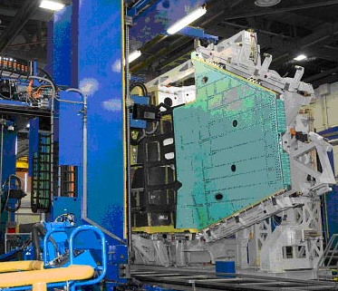
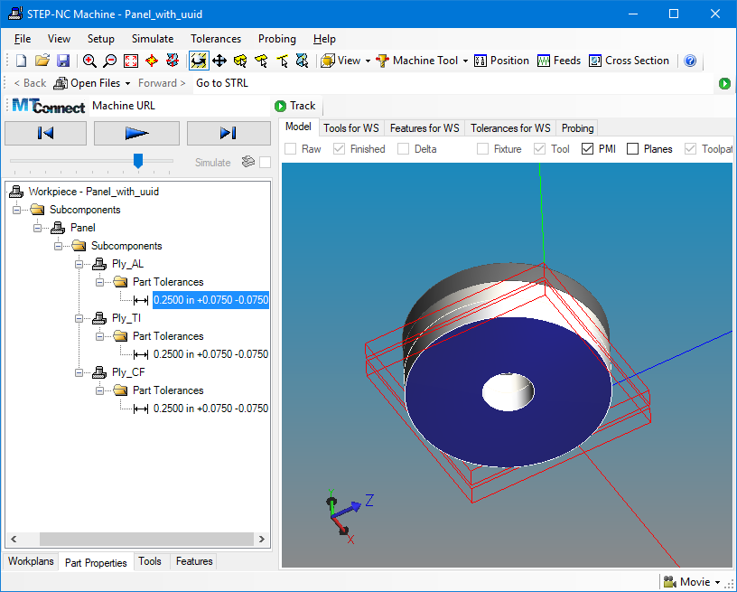
Use Case 2 – weight reduction
Exact match of fastener to hole depth can reduce weight by 500lb

Slide 7

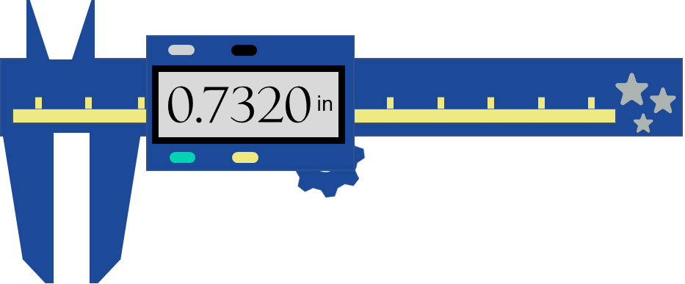
User entity
PLM/ERP
MOM
AP242
Supervisory Control
State
Machine
(supervisory)
Measurement
Analyzer
AP242
QIF Results
Core entity
Part Digital Twin
Data
cache
Models
Product/Process
Commands
Stop/Go, etc.
State Stream
Plunge complete, etc.
Measurements
Hole dimensions, etc.
Instructions
Gcodes, etc.
AP242
DCDCE
QIF results
Cell Controller
Device Control
sub-entity
Data
Cache
(caliper)
Data Collection
sub-entity
Planner
OME
Caliper
State
Machine

Slide 8
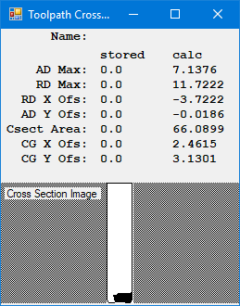
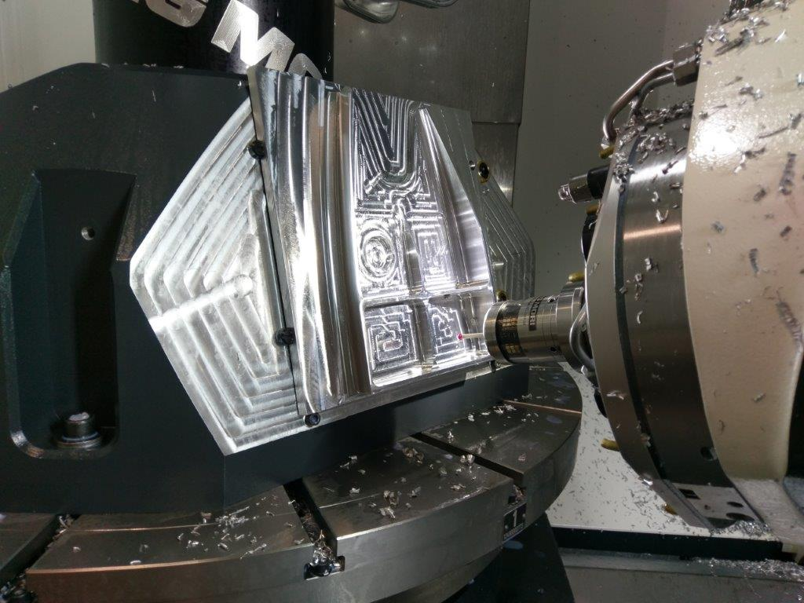
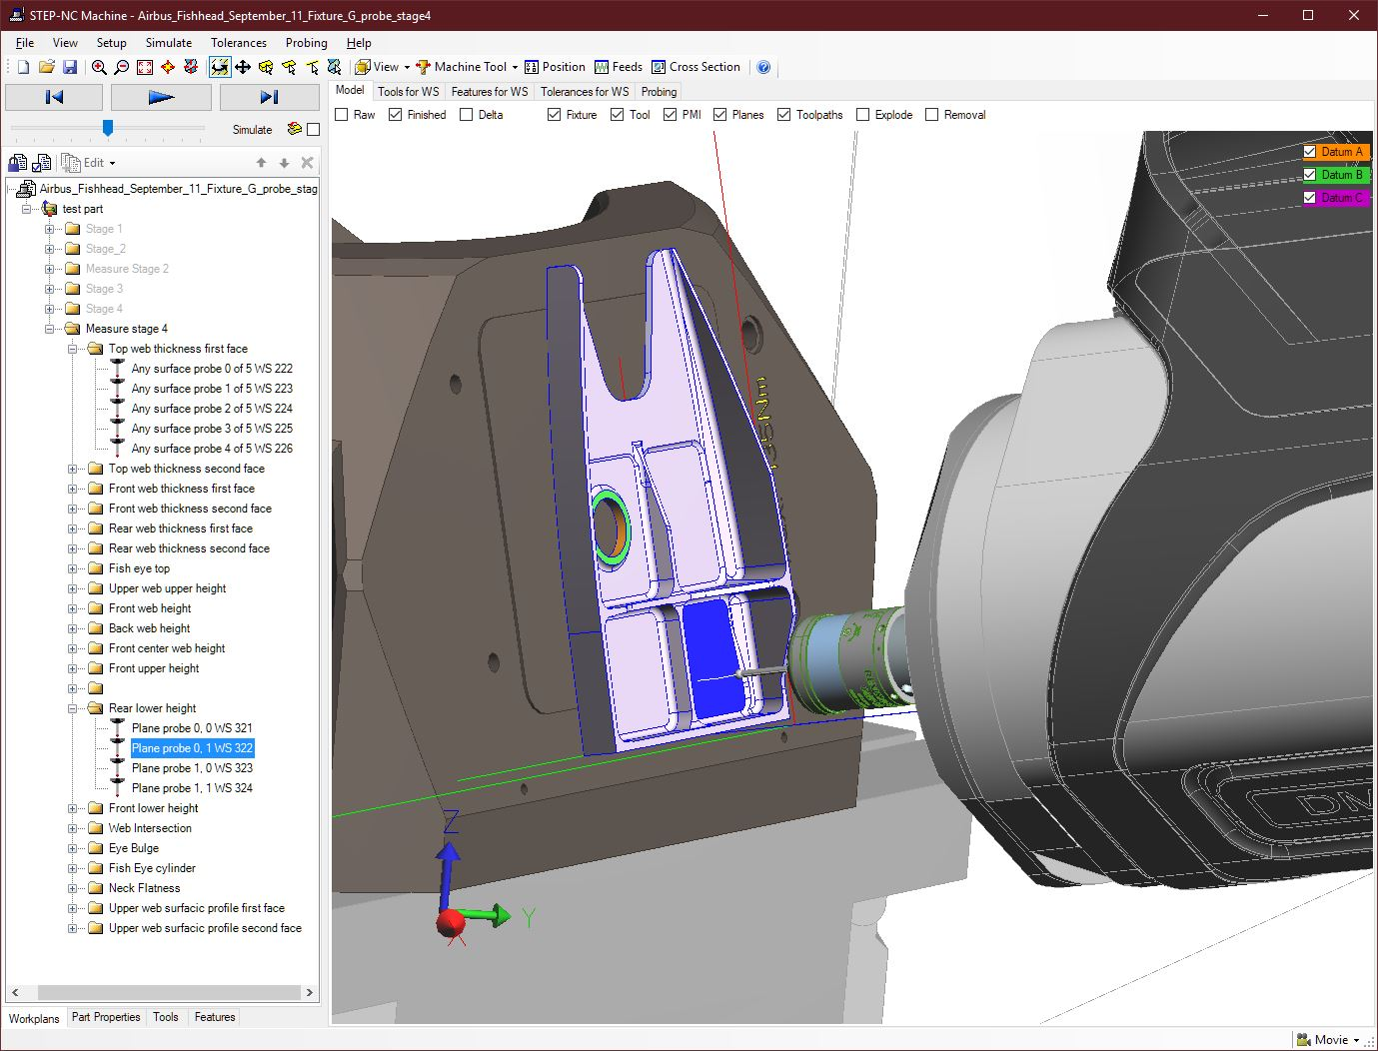
Use Case 3 – tool life optimization
Machine
parts
Monitor tool
diameter
Compute tool
engagement
Store linked data
OMAC
ANSI
STEP Tools
ISO
Machining
Context
Macros
Tool life can increase by 15%
MTConnect
STEP
Agent
STEP-NC
Gcode
ops
Stream
results
Apply
Results
Twin model

Slide 9



ISO 23247-4 Figure A.3
AP238
AP242
AP239
User entity
PLM/ERP
MOM
Supervisory Control
Tool Life Analyzer
Combiner
SANDVIK
AP238
AP242
AP242
ISO 13399
Measure actual tool wear
Estimate remaining life
Core entity
Process Digital Twin
Part Digital Twin
Tool Digital Twin
Data
cache
(process)
Data
cache
(part)
Data
cache
(equipment)
Models
Product/Process
Commands
Stop/Go, etc.
State Stream
Plunge complete, etc.
Measurements
Hole dimensions, etc.
Instructions
Gcodes, etc.
View1
View2
View3
AP238
MTConnect (with process and measurement)
DCDCE
Cell Controller
MTConnect Agent
Device Control
sub-entity
Data
Cache
(controller)
Data Collection
sub-entity
Translator
Tweets (with process)
Tweets (with measurement)
CNC
language
OME
CNC
Caliper
State
Machine
(CNC)
State
Machine
(CMM)

Slide 10
