Slide 1
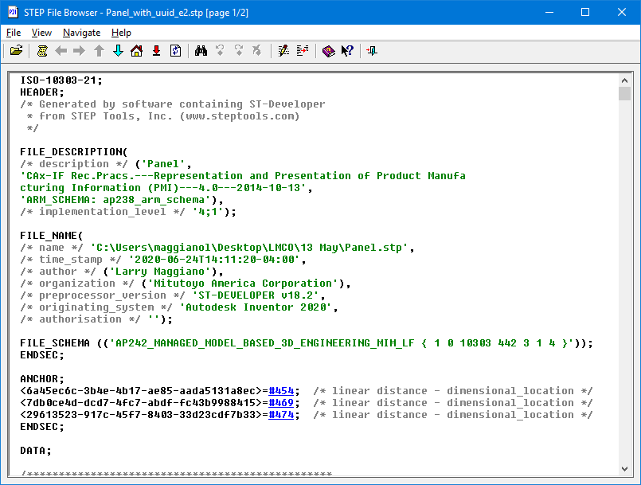
AP242 Edition 2
File format is
Part 21
Edition 3
Schema is
AP242 Edition 2

Slide 2
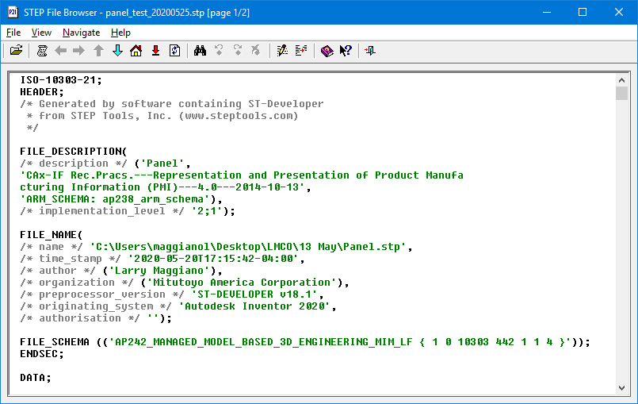
AP242 Edition 1
File format is
Part 21
Edition 1
(no UUID section)
Schema is AP242 Edition 1

