Slide 1


ISO/TC 184/SC 4 Meeting
Sunday, November 3, 2019 - Friday, November 8, 2019
Marina del rey, California, USA

Slide 2
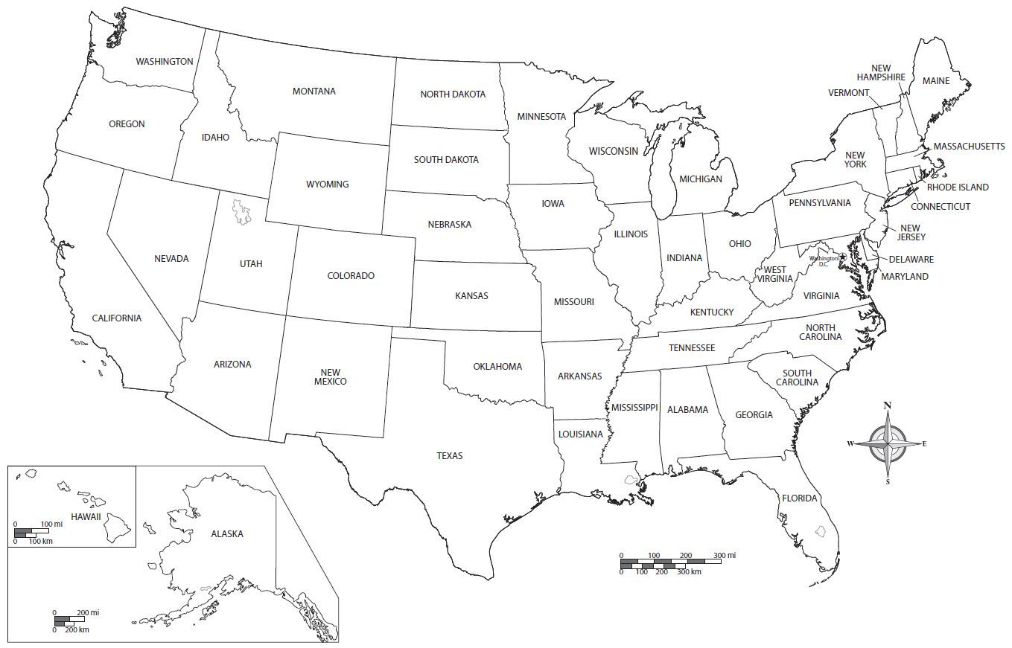
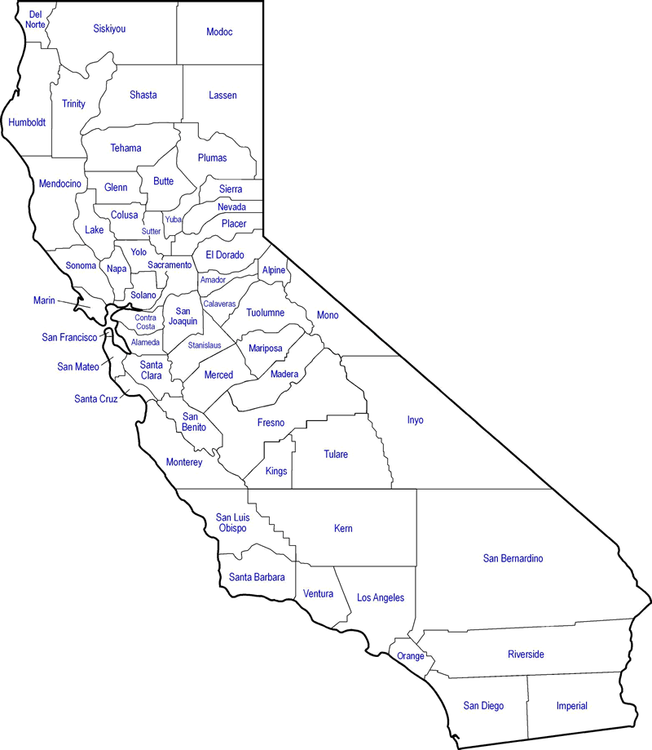






Meeting location: marina del rey, california
MAP OF THE UNITED STATES
MAP OF CALIFORNIA

Slide 3
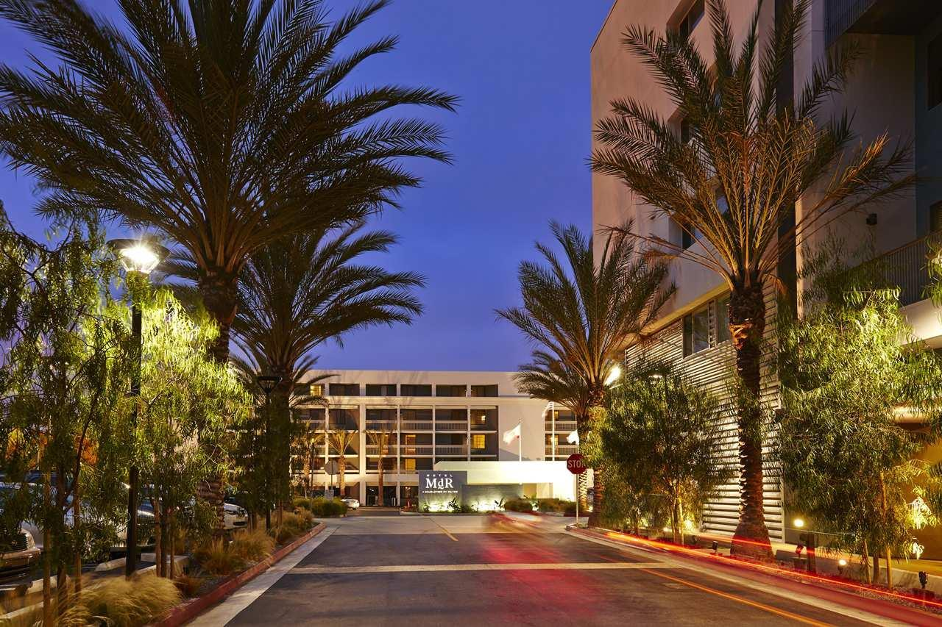
Meeting venue: hotel mdr marina del rey
ADDRESS:
13480 Maxella Avenue
Marina del Rey, CA 90292
USA
PHONE NUMBER:
+1 310-822-8555
WEBSITE:
hotelmdr.com

Slide 4
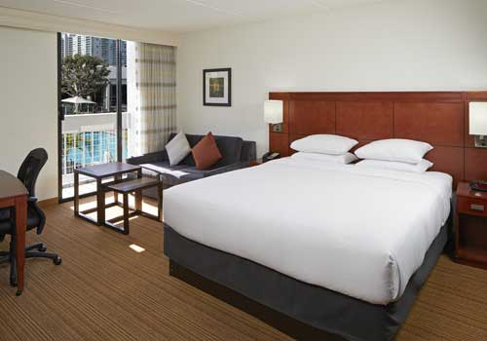
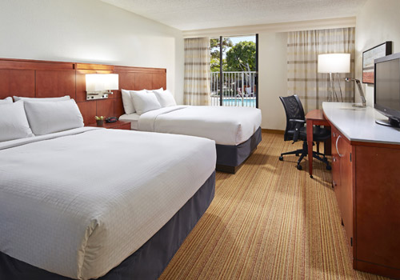
HOTEL ACCOMMODATIONS
Hotel MdR Marina Del Rey
Additional Options
Group Block Room Rate: $169.00/Night
The special room rate will be available until October 14, 2019 OR until the group block is sold out.
https://doubletree.hilton.com/en/dt/groups/personalized/L/LAXMADT-EC1-20191103/index.jhtml?WT.mc_id=POG
Nearby Hotels:
  Hilton Garden Inn Los Angeles Marina Del Rey
  Jamaica Bay Inn
  Marina Del Rey Hotel
  Marina Del Rey Marriott
  Airbnb

Slide 5
Travel: airport to meeting venue
Los Angeles International Airport (LAX)
1 World Way
Los Angeles, CA 90045
Directions from LAX (4 Miles Away)
Take Sepulveda Boulevard
Make Slight Left on Lincoln Boulevard
Turn Right on Maxella Avenue
Hotel will be on the Right

Slide 6
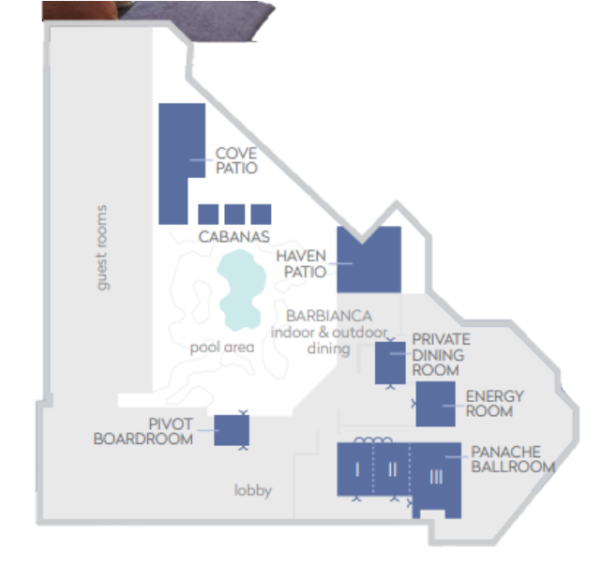
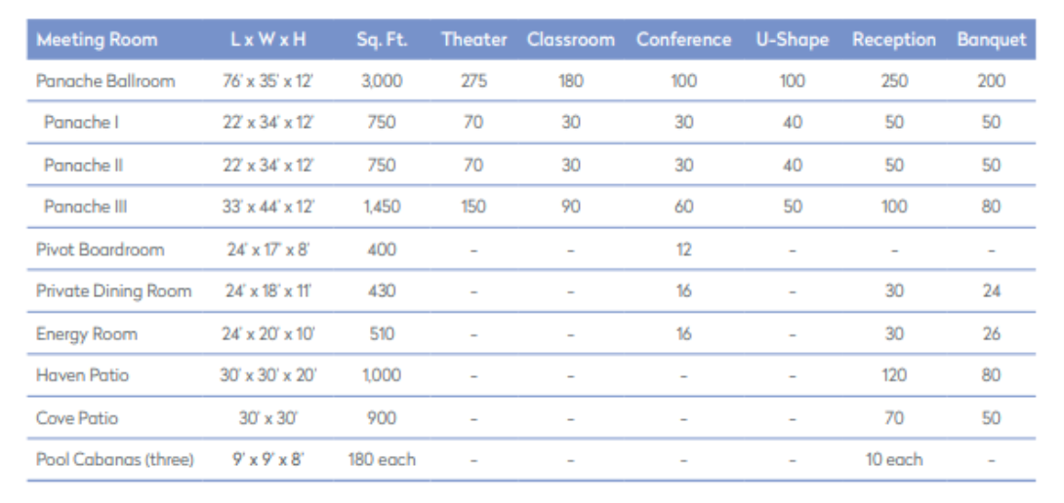



MEETING SPACE
Please contact Brandi Fisher (brandi.fisher@eccma.org)
with your meeting room requests.

Slide 7
REGISTRATION
Early Bird Registration
On or Before October 1, 2019
Regular Registration
After October 1, 2019
Full Meeting: $800 USD
Daily Participation: $235 USD Per Day
Full Meeting: $850 USD
Daily Participation: $250 USD Per Day
Monday - Thursday: Includes breakfast, morning break, lunch, and afternoon break
Friday: Includes breakfast and morning break
Social Event
Wednesday, November 6, 2019
$70 USD

Slide 8
Contact information
ECCMA
2980 Linden Street, Suite E2
Bethlehem, PA 18017
USA
Ms. Brandi Fisher
Email: brandi.fisher@eccma.org
Phone: +1 610-861-5990

Slide 9
THINGS TO DO IN MARINA DEL REY
Hotel MdR is located less than a half-mile from the marina!
Retail Shops, Department Stores, and Unique Boutiques:
  Marina Marketplace - Adjacent to Hotel
  Waterside - 0.8 Miles
  Fisherman’s Village - 1.5 Miles
  The Runway Playa Vista Shopping Mall - 1.8 Miles
  Abbot Kinney Boulevard - 2.5 Miles
  Third Street Promenade - 4.2 Miles
  The Grove/Farmer’s Market - 10 Miles
  Rodeo Drive Beverly Hills - 11 Miles
Beaches:
  Venice Canals - 2 Miles
  Playa del Rey Beach - 2.5 Miles
  Venice Beach - 2.5 Miles
  Santa Monica Beach & Pier - 4 Miles
  Dockweiler State Beach - 5 Miles
  Manhattan Beach - 9 Miles
  Malibu - 10 Miles

