Slide 1
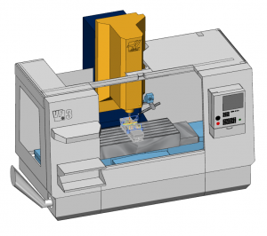
Type 1
Type 2
Type 3
Digital Twin Core
Digital Twin Core
Digital Twin Core
MTConnect client
MTConnect client
MTConnect client
MTConnect client
MTConnect agent
MTConnect agent
MTConnect agent
MTConnect agent
MTConnect agent
Physical Manufacturing Entity (PME)
Physical Manufacturing Entity (PME)
Physical Manufacturing Entity (PME)
Physical Manufacturing Entity (PME)
Physical Manufacturing Entity (PME)
Type 4
Physical Manufacturing Entity (PME)
Physical Manufacturing Entity (PME)
MTConnect agent
MTConnect client
Digital Twin Core
Digital Twin Core
MTConnect client
MTConnect agent

Slide 2
Type 3
Digital Twin Core
Cyber-physical Production System (CPPS)
Cyber-physical Production System (CPPS)
MTConnect client
MTConnect client
MTConnect agent
MTConnect agent
Physical Manufacturing Entity (PME)
Physical Manufacturing Entity (PME)

