Slide 1
Digital Twin RA structure
Reference Architecture
Information
modelling
In-loop
simulation
Information
exchange
Identification of
Information objects
derives
Requirements
considered by
Reference model
described by
Architectural views
Functional view
Networking view

Slide 2
Entity-based DT RM
Digital Twin User Entity (DTUE) (including human, devices/HMI, MES, ERP and so on)
Network Entity (NE)
Digital Twin
Operation & Management Sub-system Entity (OMSE)
Application & Service Sub-system Entity (ASSE)
Resource Access & Interchange Sub-system Entity (RAISE)
Data Collecting & Controlling Device Entity (DCCDE) (e.g., sensors, actuator)
Physical Manufacturing Element Entity (PMEE)
(e.g., physical asset, personnel, equipment)
Digital Twin System
Legend
Digital Twin System
Device/Sub-system/System
Digital Twin
Physical manufacturing elements

Slide 3
Domain-based DT RM
User Domain (UD)
Operation & Management Domain (OMD)
Application & Service Domain (ASD)
Resource Access & Interchange Domain (RAID)
Data Collecting & Controlling Domain (DCCD)
Digital Twin System
Physical Manufacturing Element Domain (PMED)

Slide 4
Relationship of entity based and domain based DT RM
User Domain (UD)
Digital Twin User Entity (DTUE)
Digital Twin
Operation & Management Domain (OMD)
Application & Service Domain (ASD)
Resource Access & Interchange Domain (RAID)
Operation & Management Sub-system Entity (OMSE)
Application & Service Sub-system Entity (ASSE)
Resource Access & Interchange Sub-system Entity (RAISE)
Digital Twin
Data Collecting & Controlling Domain (DCCD)
Data Collecting & Controlling Device Entity (DCCDE)
Digital Twin System
Physical Manufacturing Elements Domain (PMED)
Physical Manufacturing Element Entity (PMEE)

Slide 5
Functional view DT RA
Domain Specific Functional Element (FE)
User Domain (UD)
User Interface FE
Operation & Management Domain (OMD)
Application & Service Domain (ASD)
Resource Access & Interchange Domain (RAID)
Synchronization FE
O&M Support FE
Simulation FE
Reporting FE
Interoperability Support FE
Plug & Play Support FE
Visualization FE
Virtual Modeling FE
Analytic Service FE
Application Support FE
Access Control FE
Peer Interface FE
Information Exchange FE
Data Assurance FE
Security Support FE
Cross-Domain Functional Element (FE)
Data Collecting & Controlling Domain (DCCD)
Data Collecting FE
Data Pre-Processing FE
Controlling FE
Actuation FE
Identification FE
Physical Manufacturing Elements Domain (PMED)
Identifier
Elements-peculiar FEs

Slide 6
Functional view DT RA
Entity Specific Functional Element (FE)
Digital Twin User Entity (DTUE)
User Interface FE
Operation & Management Sub-system Entity (OMSE)
Application & Service Sub-system Entity (ASSE)
Resource Access & Interchange Sub-system Entity (RAISE)
Synchronization FE
O&M Support FE
Simulation FE
Reporting FE
Interoperability Support FE
Plug & Play Support FE
Visualization FE
Virtual Modeling FE
Analytic Service FE
Application Support FE
Access Control FE
Peer Interface FE
Information Exchange FE
Data Assurance FE
Security Support FE
Cross-Entity Functional Element (FE)
Data Collecting & Controlling Device Entity (DCCDE)
Data Collecting FE
Data Pre-Processing FE
Controlling FE
Actuation FE
Identification FE
Physical Manufacturing Element Entity (PMEE)
Identifier
Elements-peculiar FEs

Slide 7
Networking view entity-based DT RA
User Domain (UD)
Digital Twin User Entity (DTUE)
Digital Twin
Operation & Management Domain (OMD)
Application & Service Domain (ASD)
Resource Access & Interchange Domain (RAID)
Operation & Management Sub-system Entity (OMSE)
Application & Service Sub-system Entity (ASSE)
Resource Access & Interchange Sub-system Entity (RAISE)
Digital Twin
Data Collecting & Controlling Domain (DCCD)
Data Collecting & Controlling Device Entity (DCCDE)
Physical Manufacturing Elements Domain (PMED)
Physical Manufacturing Element Entity (PMEE)
Legend
Proximity network
Access network
Service network
User network

Slide 8
Physical Object
(Twin)
Digital Representation (Information Model, ex STEP)
Visualisation
Digital Object
(Twin)

Slide 9
Physical Object
Data Gathering
Data Filtering
Synchronization
Data Analysis
Maintenance
Prediction / Prevention
MES / ERP
Simulation
Comparison (Real status with Production target)
Reporting
Digital Object (Digital Twin)

Slide 10
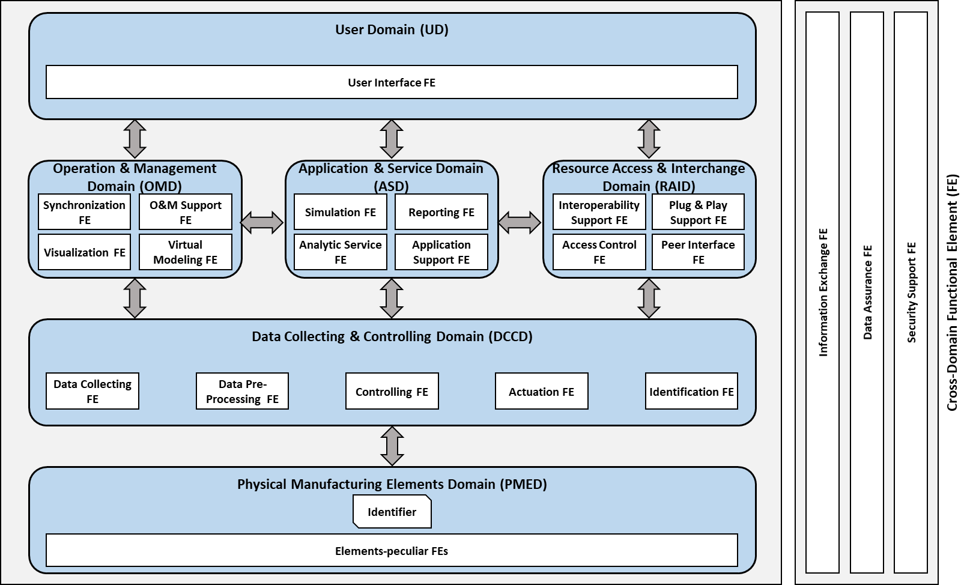
IMTS 2018 as instance of the architecture
IoT architecture (ISO 30141)
CAD / CAM /CAE
Models
DIGITAL TWIN Part 21
TwinAgent
Paths
MTConnect
CNC
Hardwick

