Slide 1

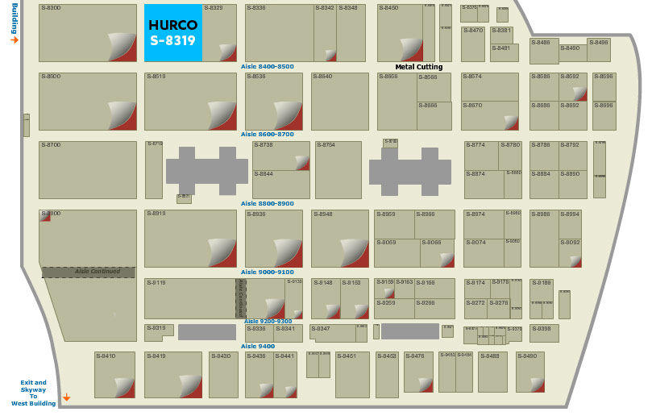
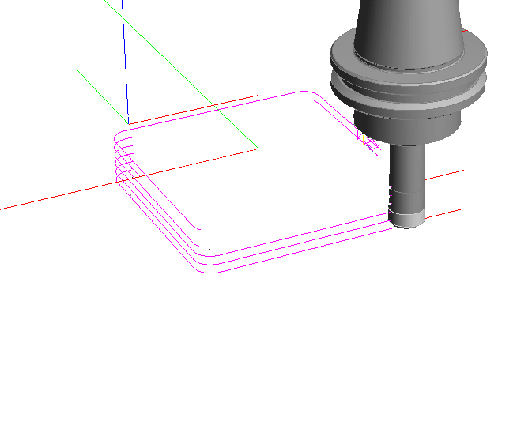
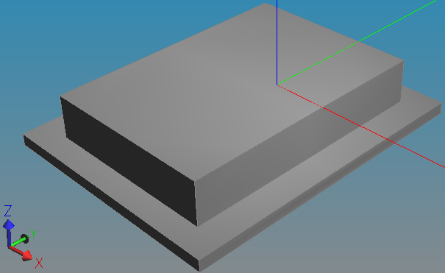
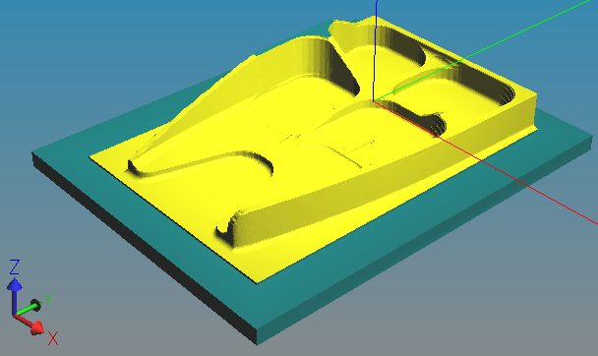
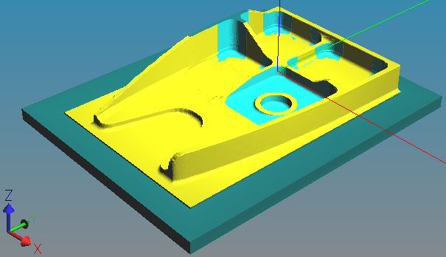
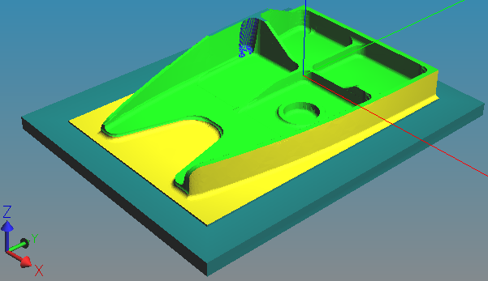
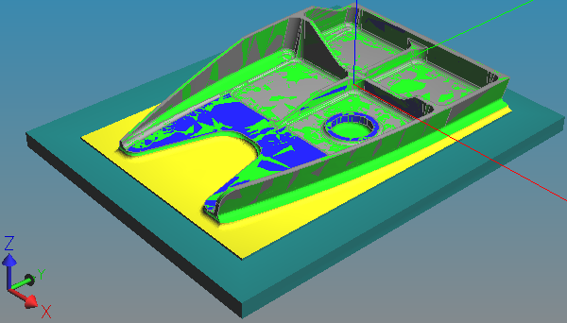
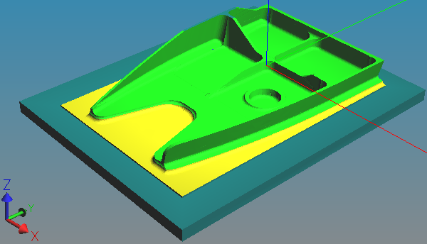
Digital Twin Machining Demonstration 2018
?
”Factory floor plan” at machine tool show
Plan process
Send workpiece through factory
Receive finished part
Machine Tool
A
Digital Twin
Machining
HUB
Machine Tool
C
1
Machine Tool
D
3
Machine Tool
B
2
Coordinate Measurement Machine
5
4

Slide 2
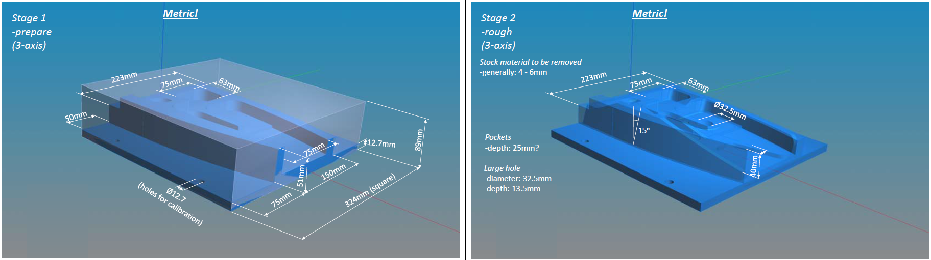
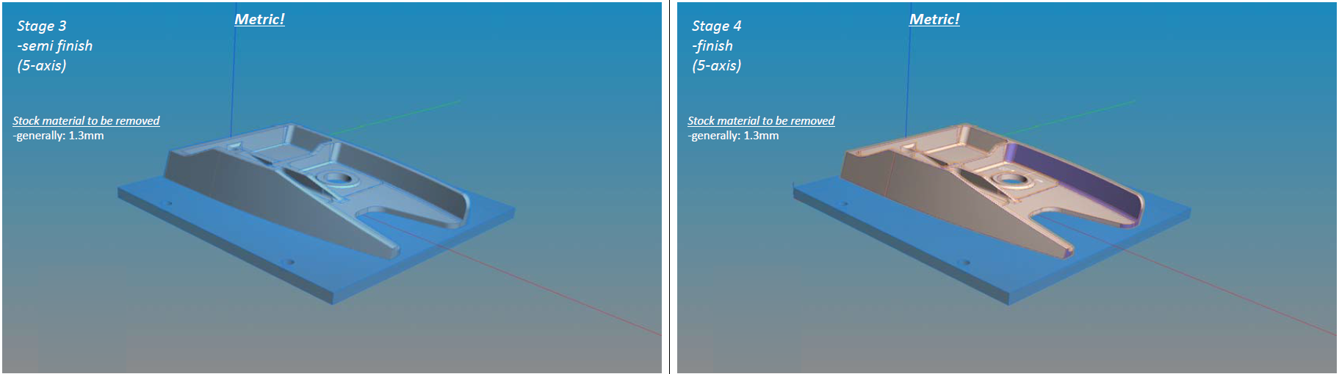
Tooling for machine with CAT50 spindle (DMG-IMTS) and HSK63 (DMG-Boeing)
Tooling ideas:
-RAL90 DC=40 RE=4 ?
-solid drill DC=12.7
Tooling ideas:
-RAL90 DC=40 RE=4 ?
-solid cutter DC=20 RE=?
Material: 7075 aluminium
Tooling ideas:
-solid cutter DC=20 RE= ?
-solid cutter DC=16 RE=4 ?
Tooling ideas:
-solid cutter DC=16 RE=4 ?
-tailor made?
R 4mm
Question to Digital Mfg Team:
Would it be possible to set
wide shoulder tolerance,
say 1.9<R<4.1 mm?
This will simplify tool availability,
since we don’t have much time to wait for custom deliveries.

Slide 3
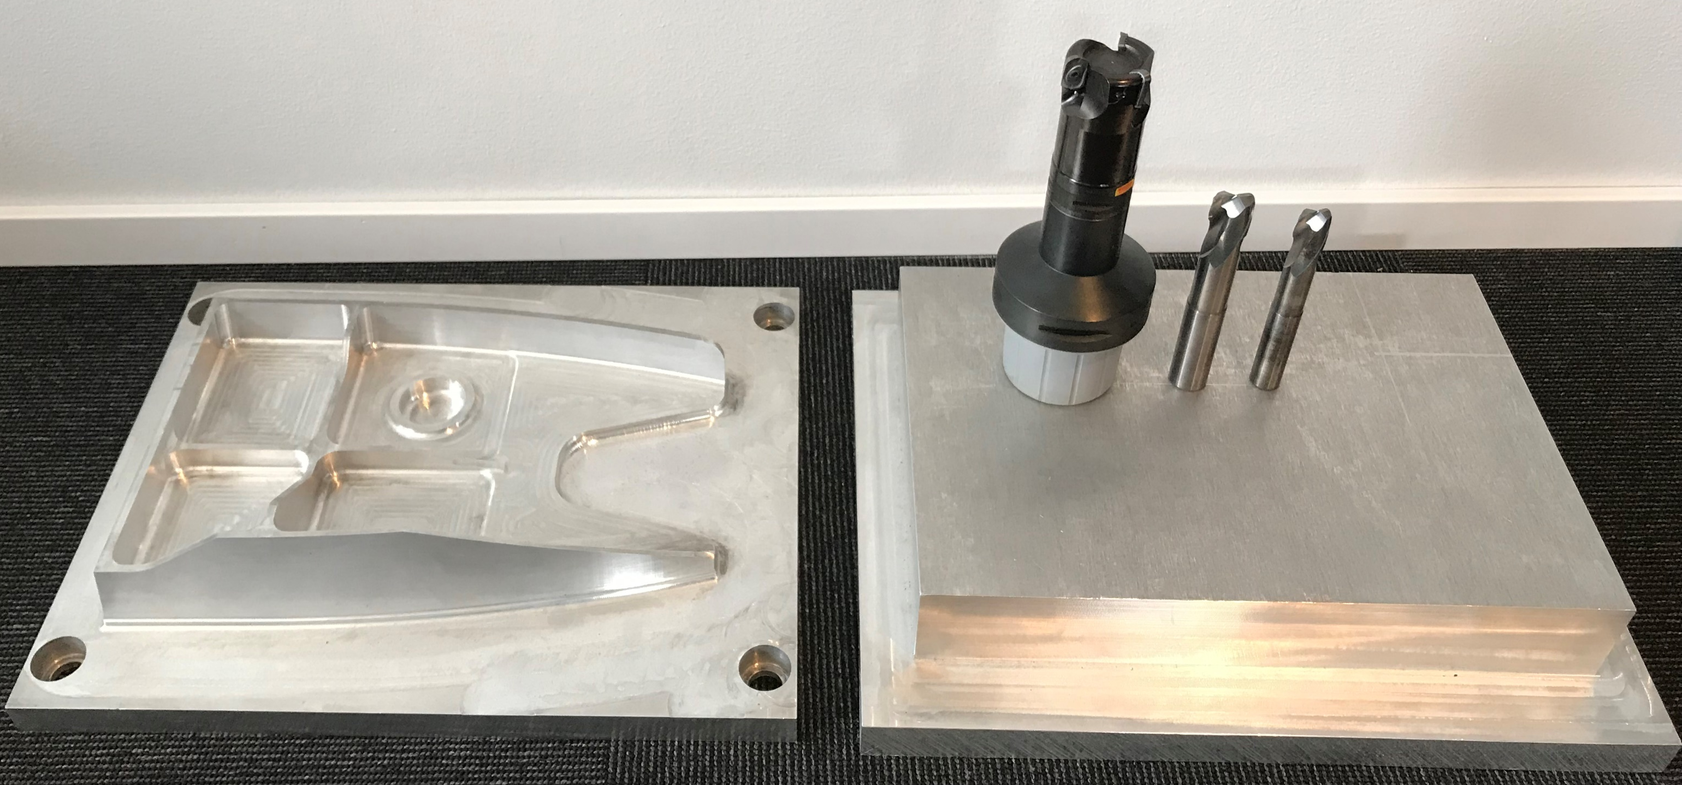
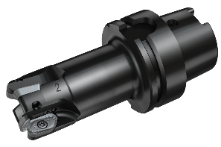
Demonstration
RAL90
Previous demonstration
DC=40mm RE=4mm indexable milling cutter
  CoroMill R790
DC=20mm RE=4mm solid milling cutter
  Two fluted CoroMill Plura
DC=16mm RE=4mm solid milling cutter
  Two fluted CoroMill Plura
Current IMTS demonstration
DC=40mm RE=4mm indexable milling cutter
  RAL90
DC=20mm RE=?mm solid milling cutter
  Three? fluted CoroMill Plura
DC=16mm RE=?mm solid milling cutter
  Three? fluted CoroMill Plura

Slide 4
operation planning –first meeting
Stage1 (3-axis roughing).
  Tooling: RAL90-040HA06L-16H with KPHT 15 04 40 FR-CM H13A inserts and 12.7mm drill 854.1-1270-05-A0 N20C or similar
  Machining strategy: tbd
Stage2 (3-axis roughing).
  Continue to use RAL90-040HA06L-16H to get closer to stage2. Then use proper solid tool to finish stage2. I guess no need to produce shoulder radius at this stage.
  Additional tooling: 2S221-2000-250-NG H10F
  Machining strategy: tbd

Slide 5
operation planning –first meeting
Stage3 (5-axis semi finish).
  Continue to use 2S221-2000-250-NG H10F to get closer to stage3
  Additional tooling: 2S221-1600-200-NG H10F
  Machining strategy: tbd
Stage4 (5-axis finishing).
  Continue to use 2S221-2000-250-NG H10F and/or 2S221-1600-200-NG H10F to get closer to stage4 and to finish stage4. Then use proper solid tool(s) to finish.
  Additional tooling: solid milling cutter with 4mm corner radius (tailor made?) as additional tooling or substitutes for the 20 and 16mm solid cutters
  Machining strategy: tbd

Slide 6
operation planning –first meeting
Tool selection – operation planning:
  Point in the right direction for tool selection (most urgent)
  Machining strategies to use
  Tool path generation
Rough time schedule:
  Set up “base-line” machining at Boeing for two conferences
    MTConnect (mid May)
    ISO conference (end of May)
  IMTS 2018 “enhancements” of base-line solution
    DMG-Mori solution (support via Germany, first meeting on Friday 20/4)

