Slide 1
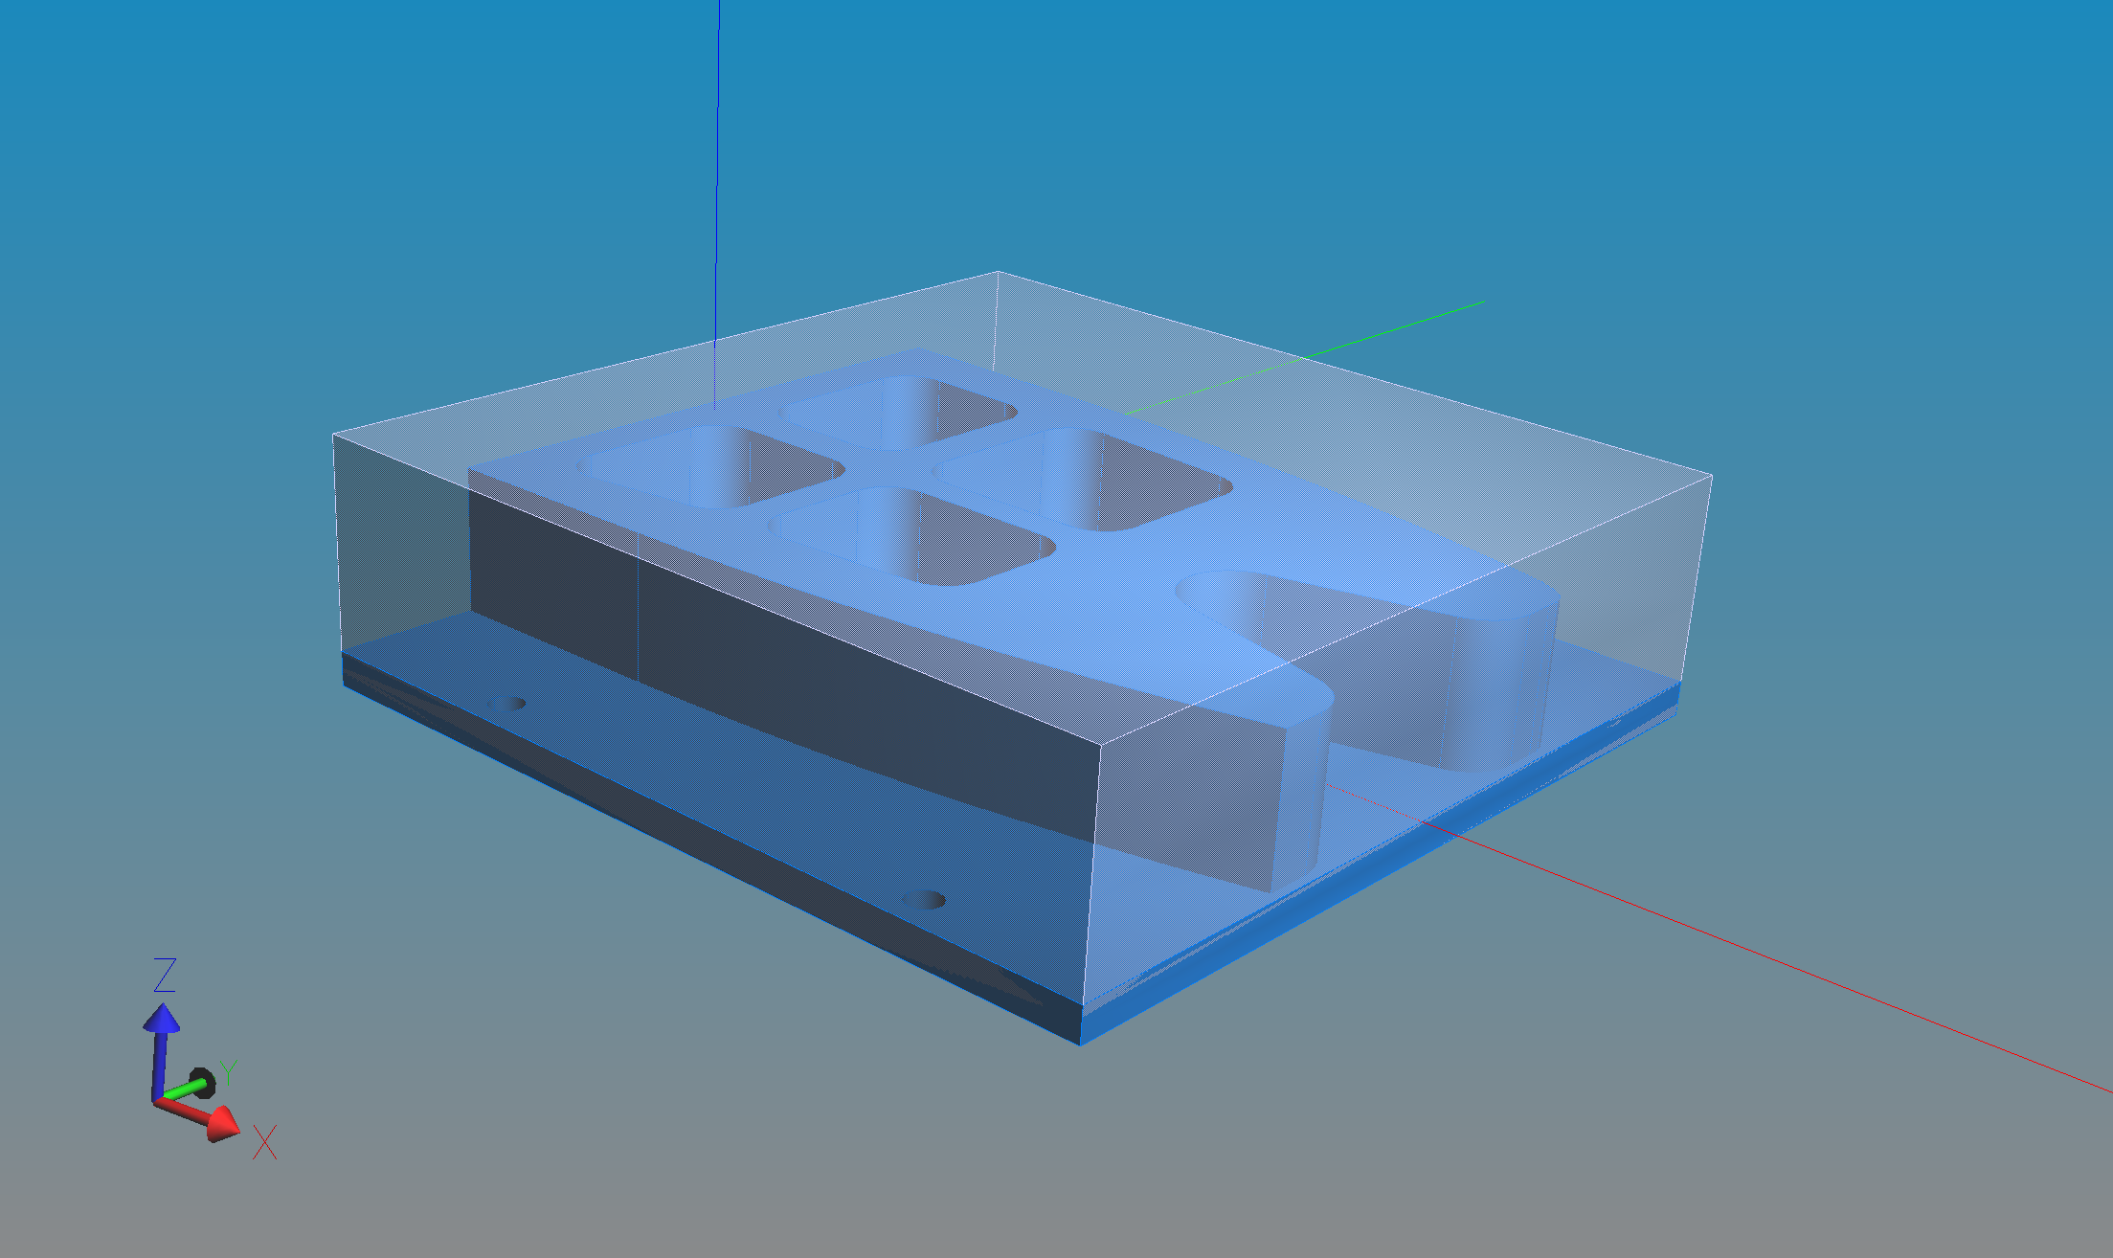
Stage 1
-prepare
(3-axis)
Inch!
1in
8.8in
3in
2.5in
R .6in
4in
2in
R .84in
3in
6in
.5in
3.5in
2in
12.75in (square)
Ø.5in
(holes for calibration)
3in

Slide 2
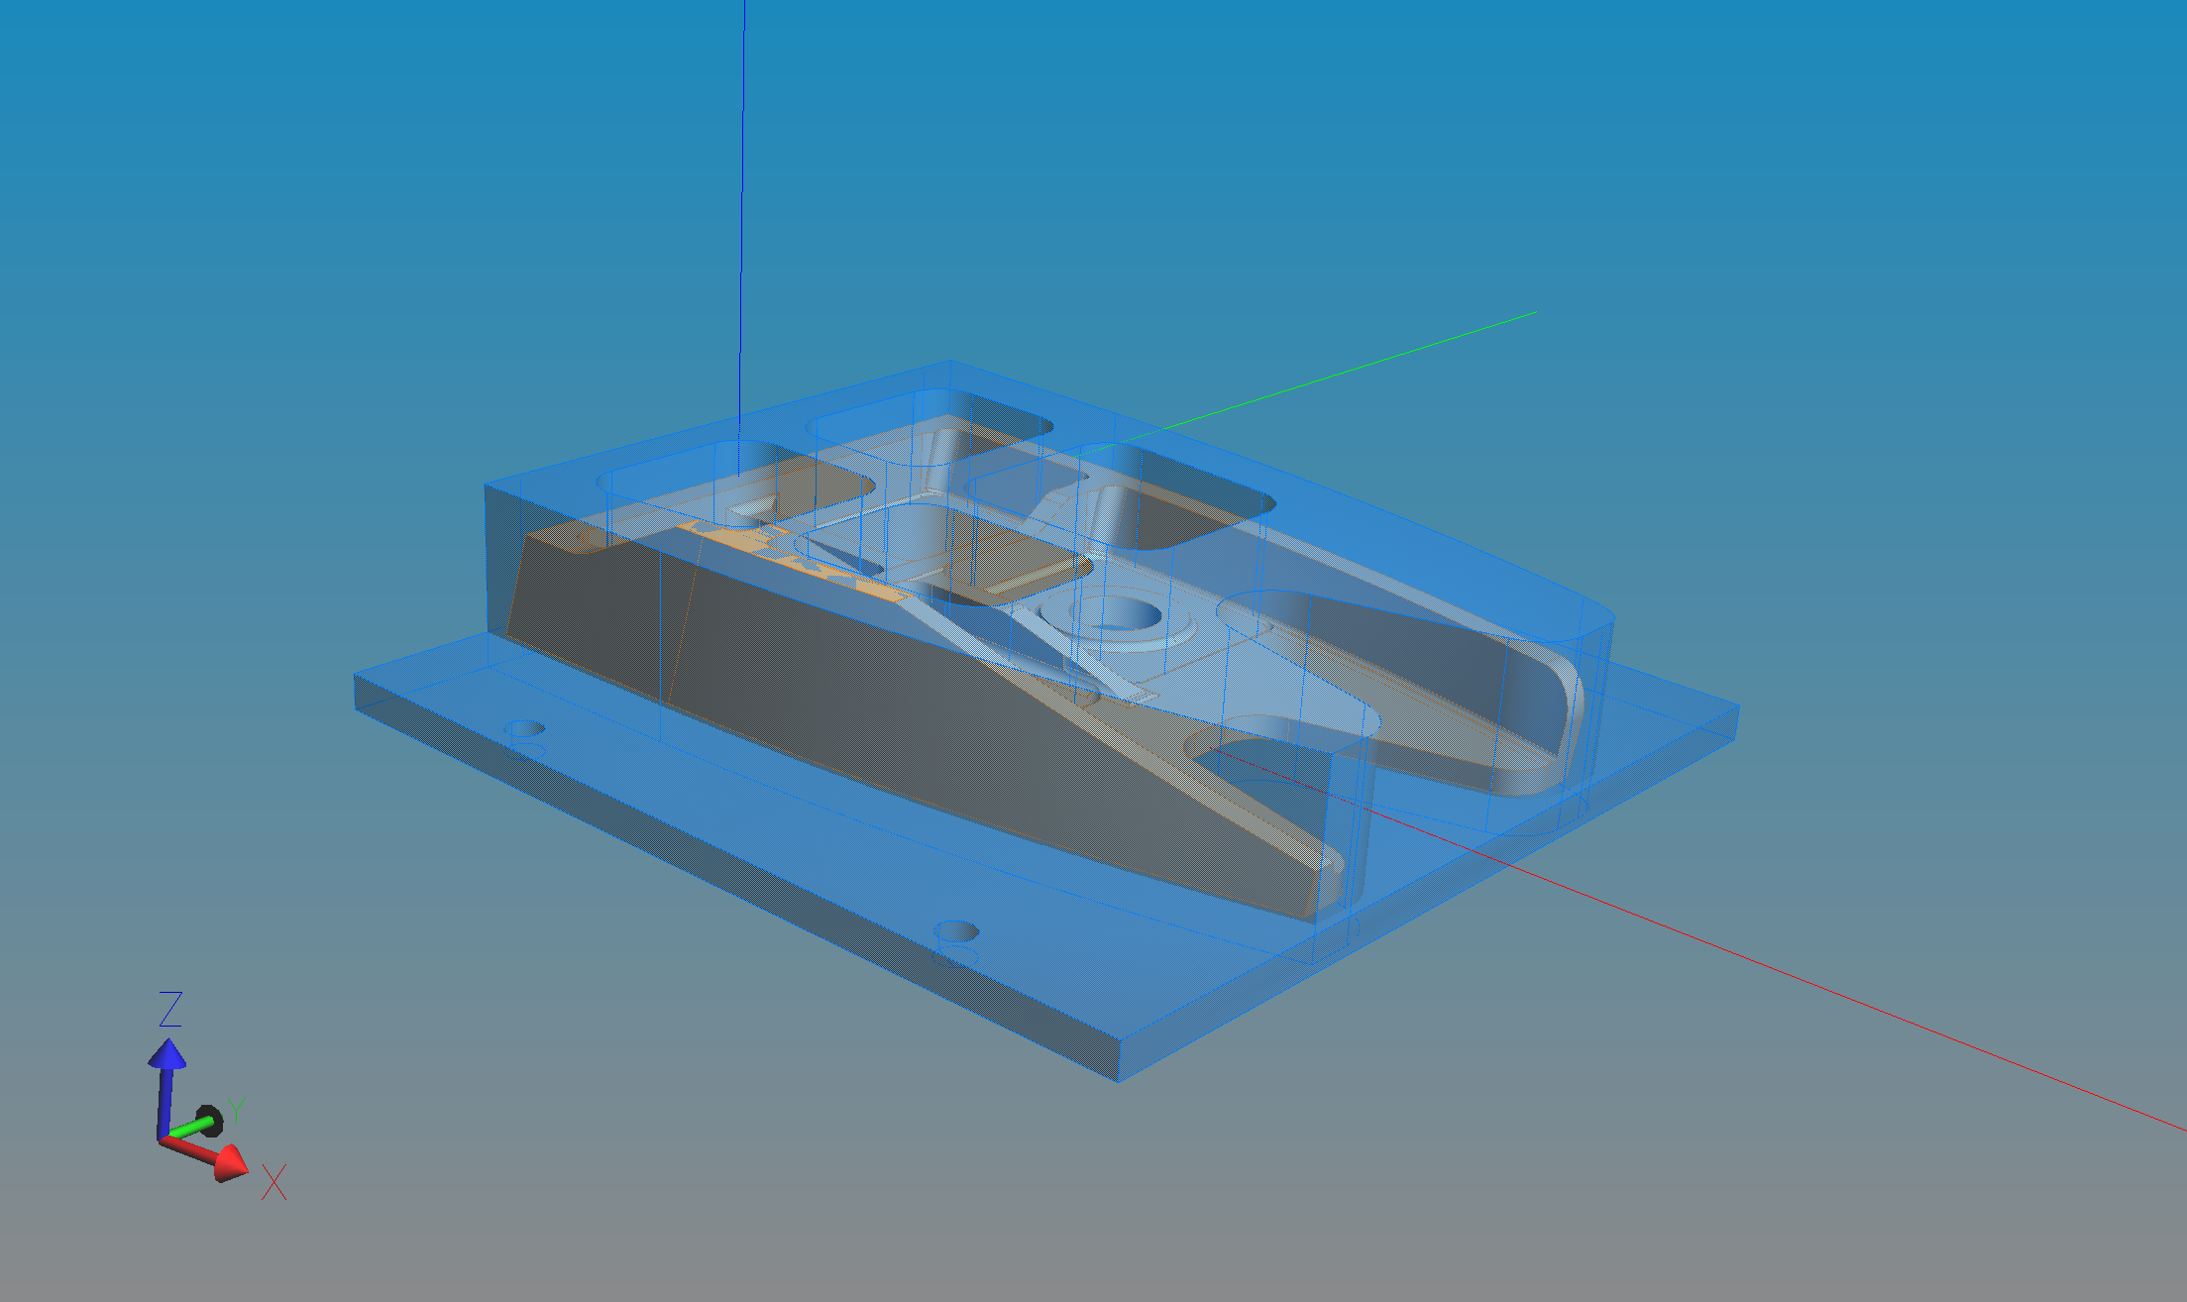
Stage 2
-rough
(3-axis)
Inch!
8.8in
3in
2.5in
Ø1.28in
4in
Work allowance external
-side: .18-.75in
-depth: 2in
15º
3in
6in
Work allowance pockets
-side: .16-.25in
-face: .03 - .04in?
(pocket depth: .99in)
2in
.42in
Large hole
-diameter: 1.28in
-depth: .53in

Slide 3
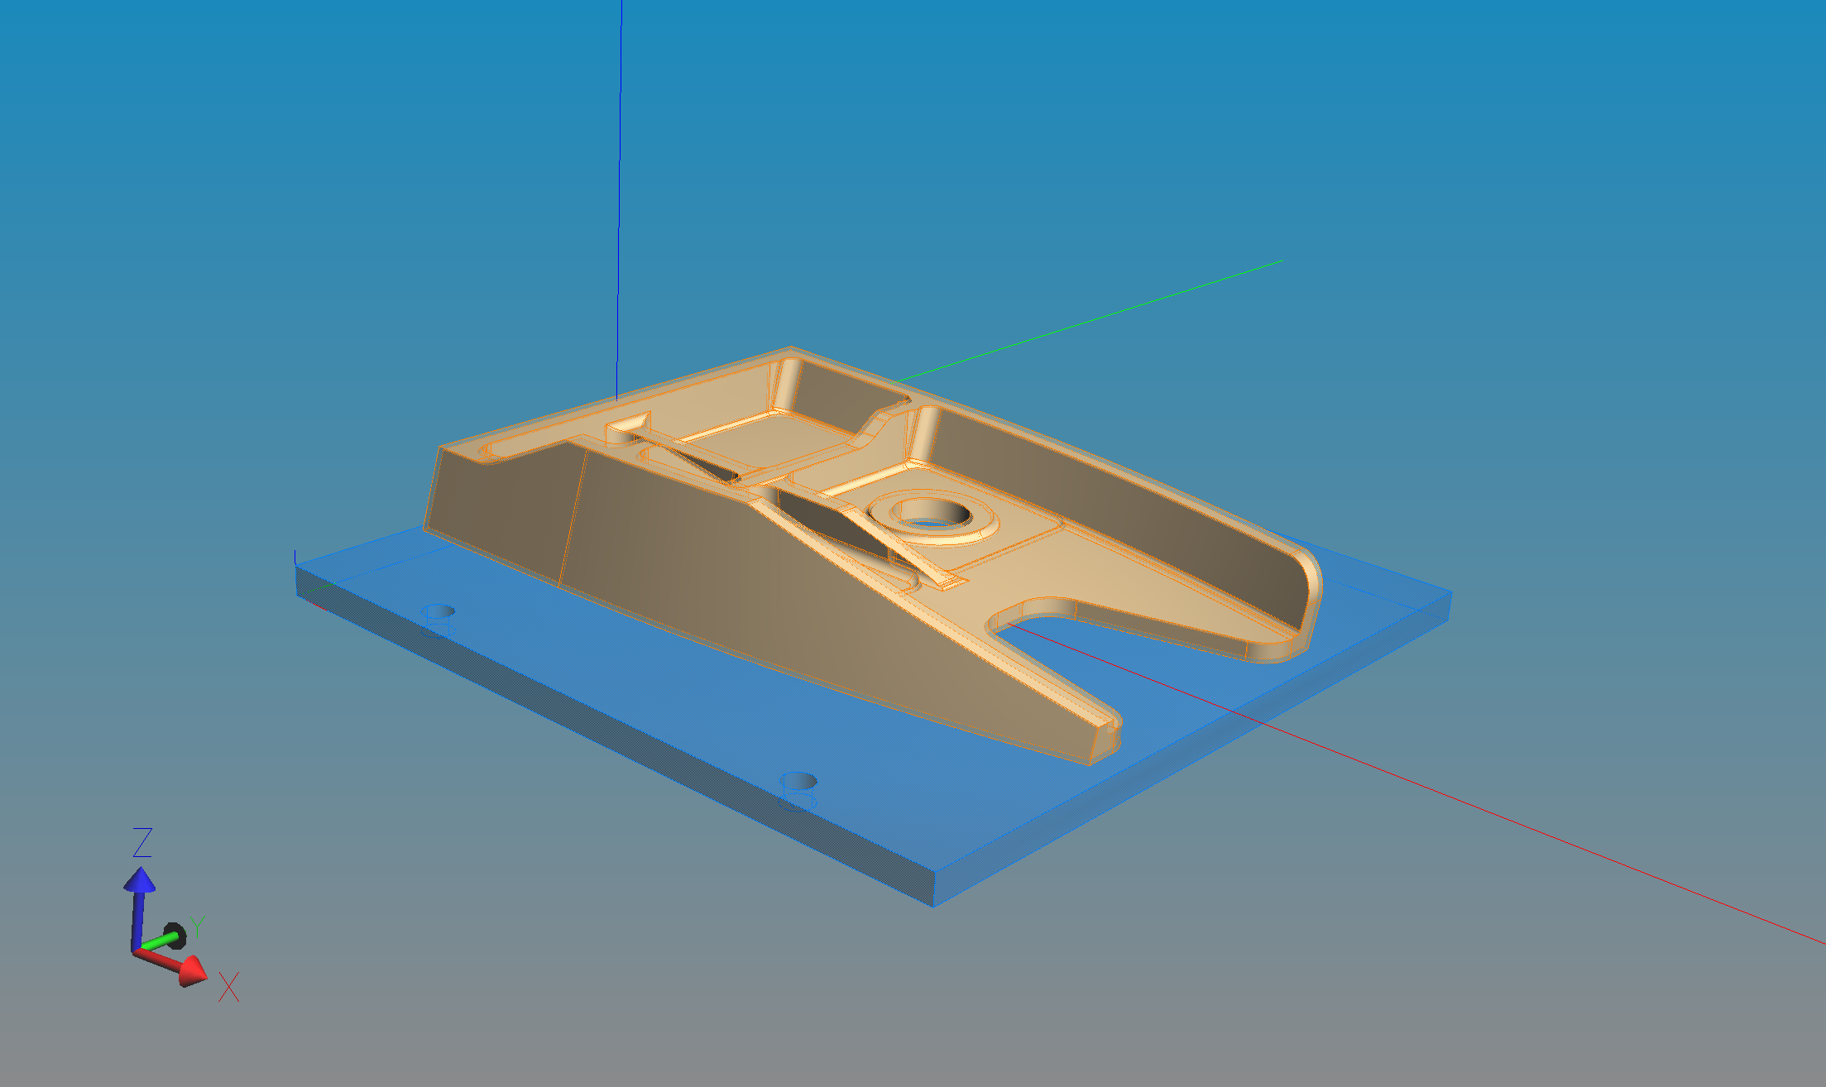
Stage 3
-semi finish
(5-axis)
Inch!
Work allowance
-generally: .05in

Slide 4
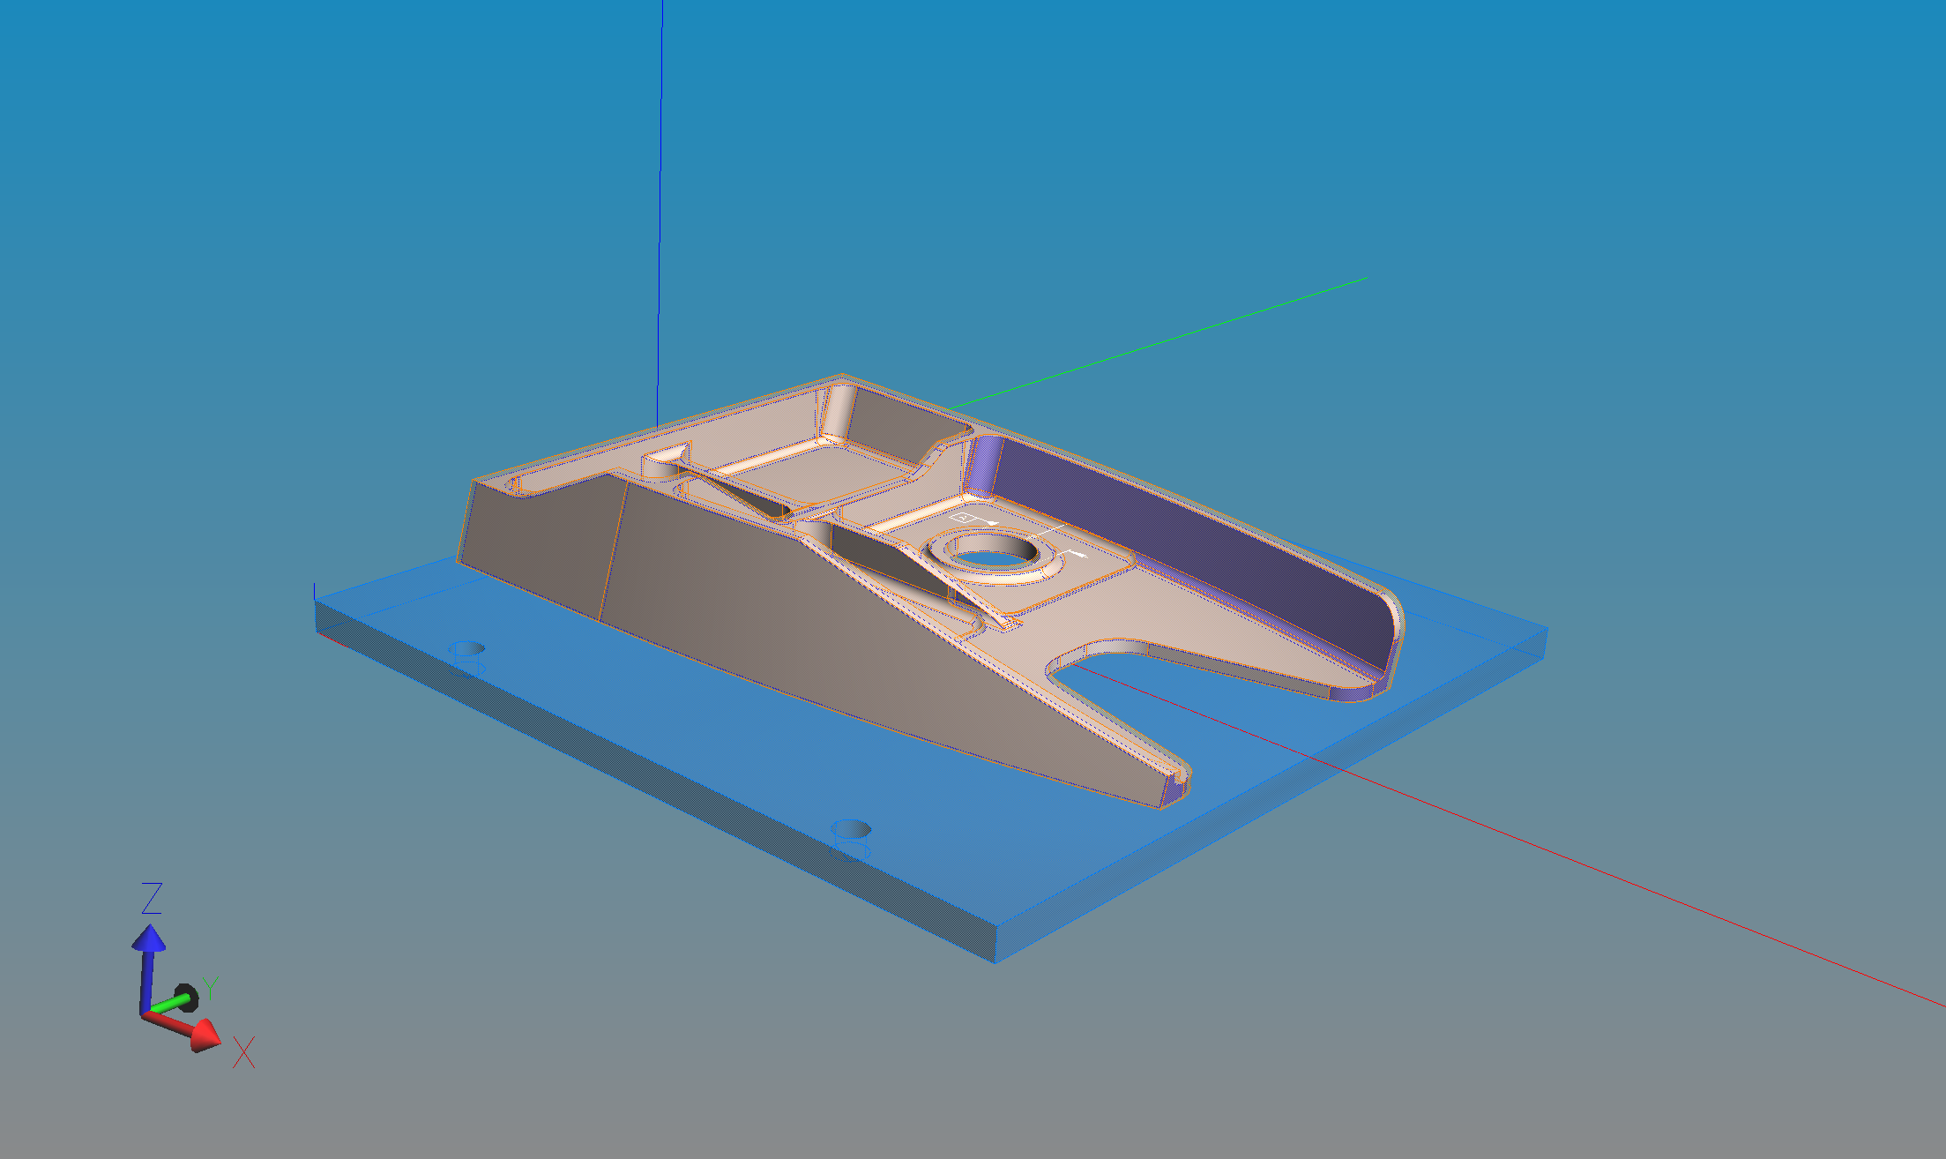
Stage 4
-finish
(5-axis)
Inch!
Work allowance
-generally: .05in

Slide 5
Stage 1
-prepare
(3-axis)
Metric!
25mm
223mm
75mm
63mm
R 15mm
100mm
50mm
R 21mm
75mm
150mm
12.7mm
89mm
51mm
324mm (square)
Ø12.7mm
(holes for calibration)
75mm

Slide 6
Stage 2
-rough
(3-axis)
Metric!
223mm
75mm
63mm
Ø32.5
100mm
Work allowance external
-side: 4.5 - 19mm
-depth: 51mm
15º
75mm
150mm
Work allowance pockets
-side: 4 – 6.35mm
-face: 0.8 – 1mm?
(pocket depth: 25mm)
51mm
11mm
Large hole
-diameter: 32.5mm
-depth: 13.5mm

Slide 7
Stage 3
-semi finish
(5-axis)
Metric!
Work allowance
-generally: 1.3mm

Slide 8
Stage 4
-finish
(5-axis)
Metric!
Work allowance
-generally: 1.3mm

