Slide 1
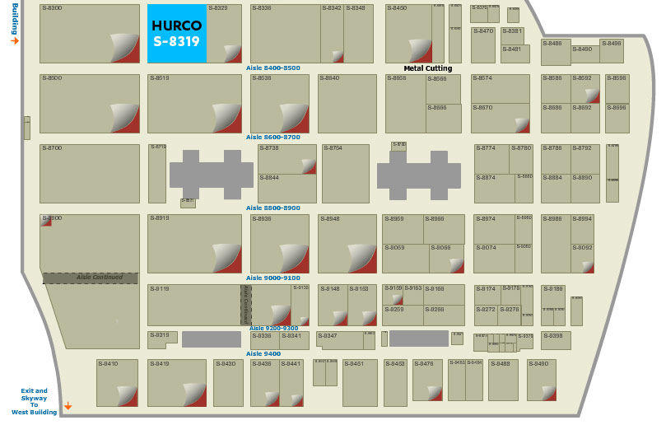
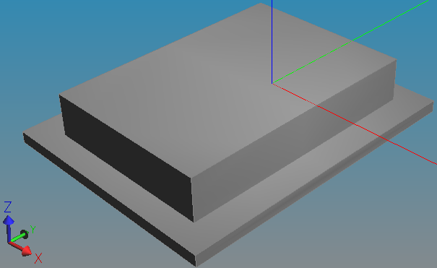
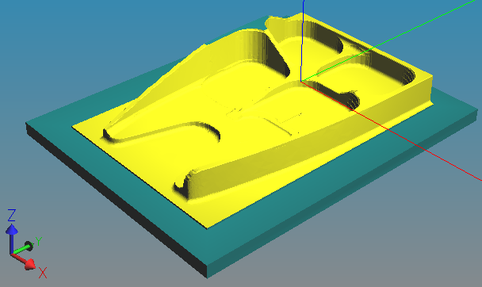
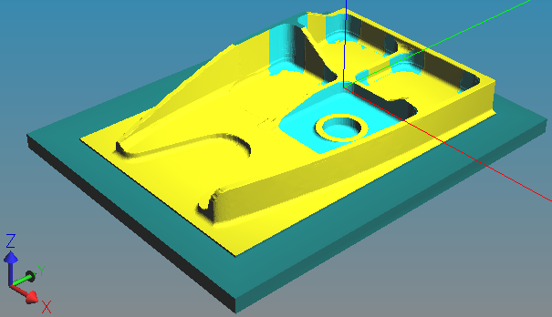
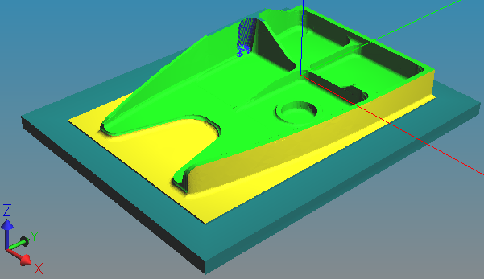
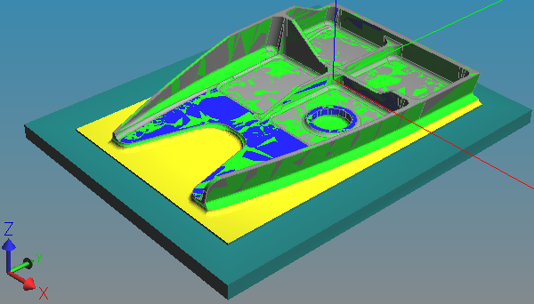
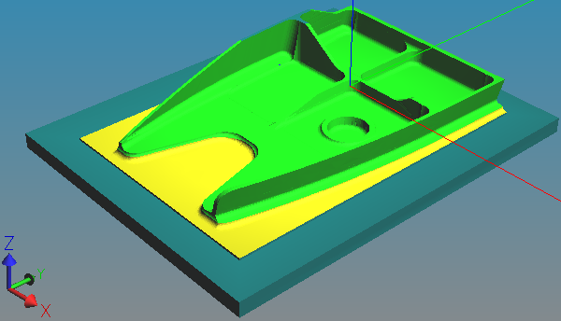
Digital Twin Machining Demonstration 2018
”Factory floor plan” at machine tool show
Plan process
Send workpiece through factory
Receive finished part
Machine Tool
A
Digital Twin
Machining
HUB
Machine Tool
C
1
Machine Tool
D
3
Machine Tool
B
2
Coordinate Measurement Machine
5
4

