Slide 1
Proposal for Collaboration STEP, QIF and MTConnect
Dr. Martin Hardwick
Professor of Computer Science, RPI
President STEP Tools, Inc.
Convener ISO WG15 Digital Manufacturing

Slide 2
Reasons to collaborate
United we stand, divided we fail
STEP is an excellent technology for product model data because it is good at long term archiving and maintaining upward compatibility for complex data translators.
MTConnect is an excellent technology for process monitoring because it is good for real time communication.
QIF is an excellent technology for results reporting because it has a rich, flexible XML data format.
Together we can deliver significant new savings to industry
Better communication makes enterprises 10% more efficient
Adaptive programming reduces machining costs by 15%
Interoperability reduces setup costs by 35%
The O3 project shows we can co-exist within a federated architecture
See the video at: https://youtu.be/n_syXtpyxgM
UUID’s enable system level integration
Necessary translators are in the design, planning and manufacturing systems

Slide 3
WG15 Federated Architecture
“ISO 10303:28 XML format for dynamic communication of product model changes between systems”
Design &
Planning System
Plan operations
STEP
QIF
O3
Demonstrated
CNC with
Twin Server
MTConnect
CMM with
Gateways
Build Parts
Measure Parts

Slide 4
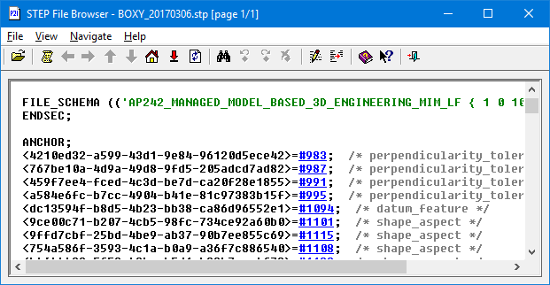
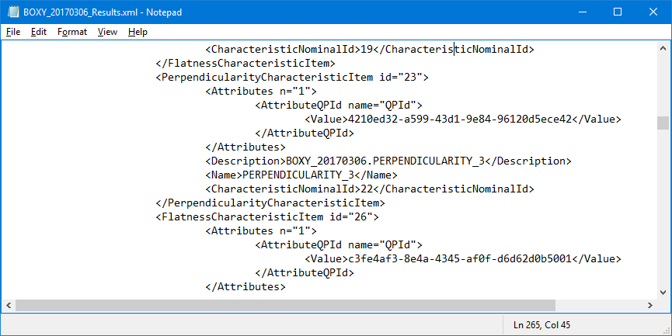
UUID’s can relate the data
STEP Data
QIF Data
MTConnect Adapter Data
Notes:
Speaker: MH
View: Slide 12
Explanation of how UUIDs enable traceable data relationships
Transition @ 48min

Slide 5
Issues to be resolved
Resolution of any conflicts between QIF MBD and STEP MBD
Validation of STEP coverage of ANSI Y14
Adoption of UUID’s by the CAX-IF
Integration of ideas and enhancements from Europe and the Far East
Recommended practices for CAD, CAM, CNC and CMM vendors
Definition of the new Part 28

