Slide 1
Classification of requirements
ISO TC184 SC4 WG15 2017-04-19

Slide 2
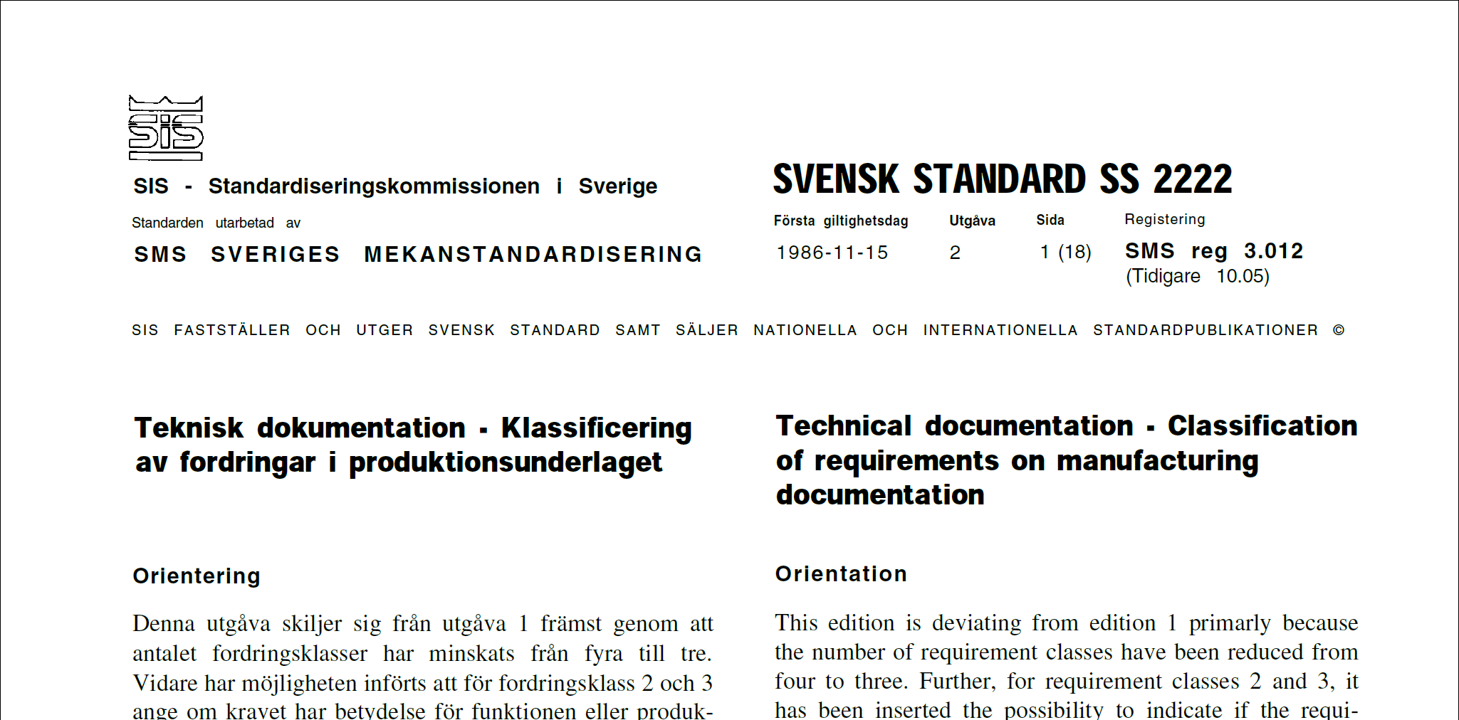
Classification of requirements
SS 2222:1986, Technical documentation — Classification of requirements on manufacturing documentation. SIS Swedish Standards Institute.
NS 1450-1987, Technical drawings - Technical documentation - Classification of requirements in manufacturing documents. Standard Norge.
DS 2339-1987, Classification of requirements on manufacturing documents, Danish Standards Foundation.
SFS 5315:1987 Withdrawn, Technical documentation. Classification of requirements on manufacturing documentation, Finnish Standards Association SFS.

Slide 3
Classification of requirements
SS 64004:2014 Consequence classification for welded joints
Critical Characteristic [CC]
Significant Characteristic [SC]
Example
Severity (safety, economic, environment)
[CC]
[SC]
Standard
Susceptibility (level of deviation to impair function)

Slide 4
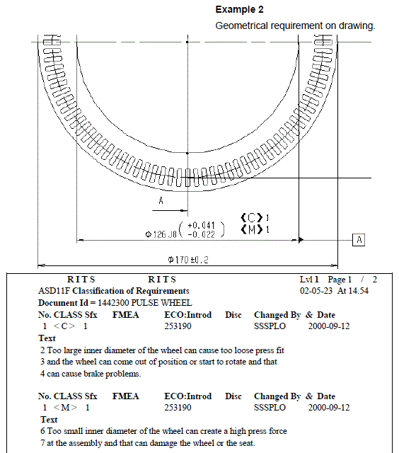
Special characteristics
Example
Scania standard STD3944
Critical <C>
Major <M>
Standard
Legal <L>
Severity (safety, economic, environment)
<C>
<M>
Standard
Susceptibility (level of deviation to impair function)

Slide 5
Special characteristics
Examples
Volvo Group standard STD 105-0007
Critical Characteristics [CC] refer to special characteristics which can affect safety;
Significant Characteristics [SC] refer to special characteristics which can affect compliance with regulations (for emission regulations use STD 105-0004), form, fit, function and performance, or subsequent manufacturing-process steps.

Slide 6
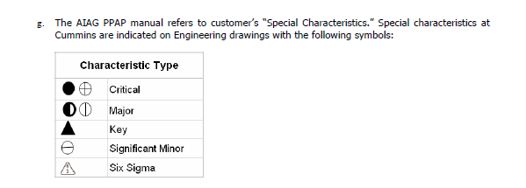
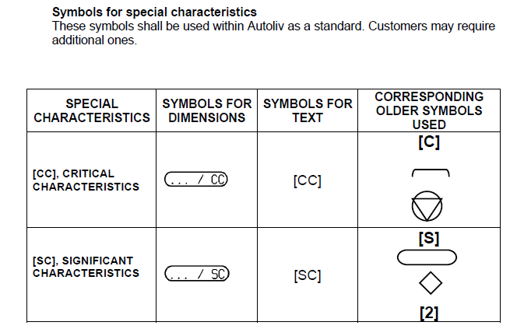
Special characteristics

Slide 7
Key characteristics
EN 9103:2012 Aerospace series — Quality management systems — Variation management of key characteristics
Critical Item (CI) Those items (e.g., functions, parts, software, characteristics, processes) having significant effect on the product realization and use of the product; including safety, performance, form, fit, function, producibility, service life, etc.
Key Characteristic (KC) An attribute or feature whose variation has a significant influence on product fit, performance, service life, or producibility.
Key Characteristic (KC) Owner
Key Characteristic (KC) Process Owner
Normative procedure to meet requirements for variation management
Process control documentation

Slide 8
Conclusion
Proposal for ISO standard on classification of requirement
Define a generic classification system
Allow assignment in the detailing of a tolerance upper or lower limit
Allow organisation specific types of notations and symbols
Allow organisation specific classification levels
Allow organisation specific assessment procedures
Allow organisation specific process capability requirements
Give examples of working classification systems

Slide 9
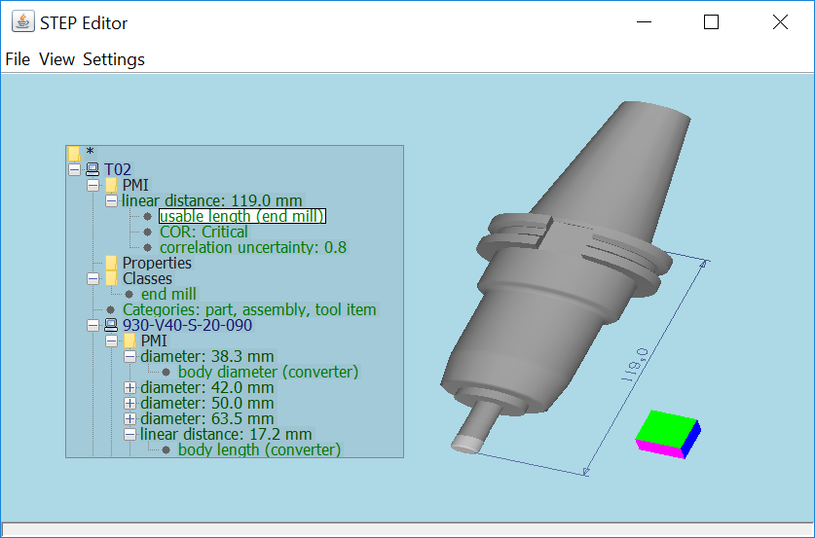
STEP editor developed by KTH Royal Institute of Technology

