Slide 1
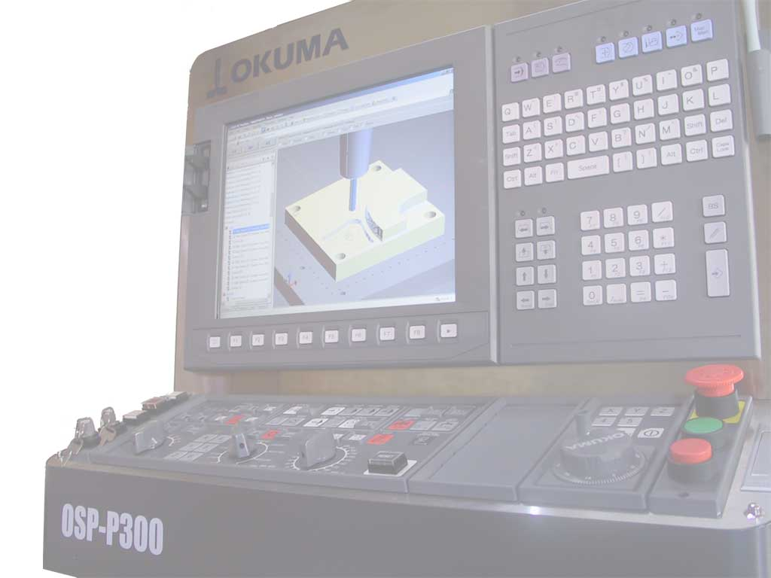
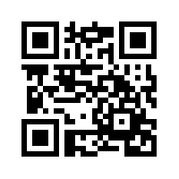
Standards for the Digital Thread
Integrated Measurement
February, 2017
Martin Hardwick
President STEP Tools, Inc.
Professor of Computer Science, RPI
Convener ISO STEP Digital Manufacturing
STEP Tools, Inc.
http://www.steptools.com

Slide 2
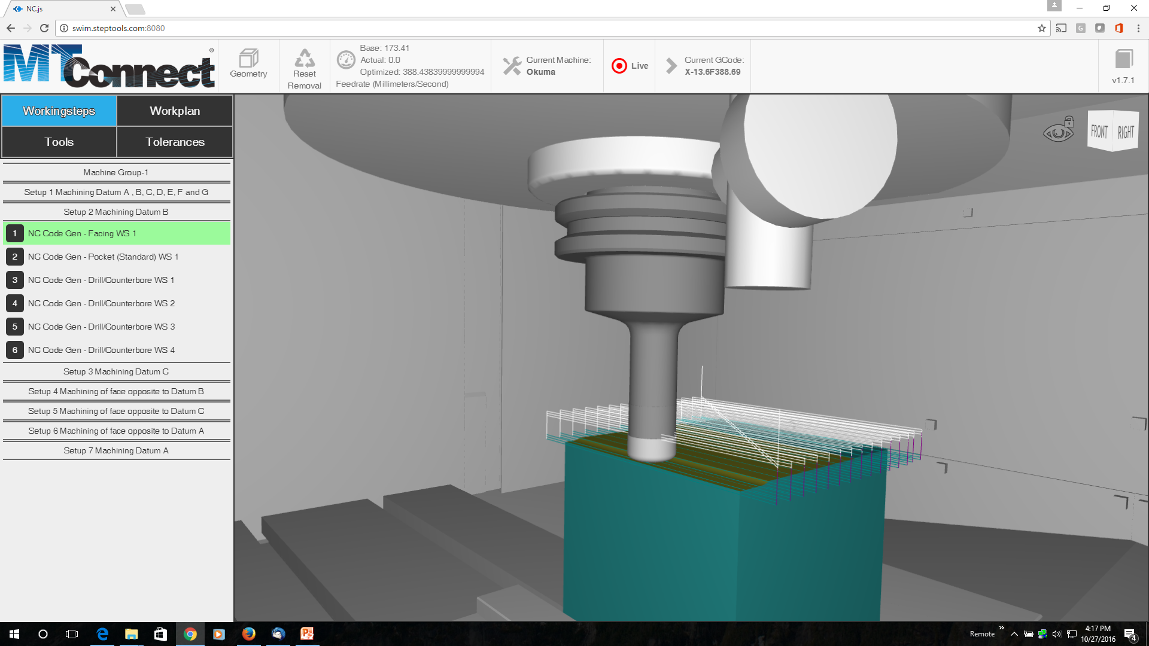
Smart Phone or Browser

Slide 3
Scenario
Operation is close to its limits
Tool wear issue
Remote operator wants it checked
Probe plan determined in advance
Initiated from a remote location
Evaluated from a remote location

Slide 4
Actions
Cutter sent from catalog with tool wear
Gcode sent to machine with probing macros and UUID’s for touch points
STEP sent to CMM with associations between touch points and tolerances
MTConnect sent from machine with probe results and UUID’s
QIF sent from CMM for evaluation

Slide 5
Digital Thread
Operation
Smart Phones and Tablets
Inspection
HTML 5
1
Tooling
3
Smart
Metrology
Service
(Virtual CMM)
Smart
Tooling
Service
(Catalog)
AP242
Digital Twin Server
AP242
2
5
MTConnect
4
G-code
QIF
CNC Machine

Slide 6
Evaluation
MTConnect
Positional data, limits compliance
STEP
CAD data, GD&T compliance
QIF
Measurements, regulation compliance

