Slide 1
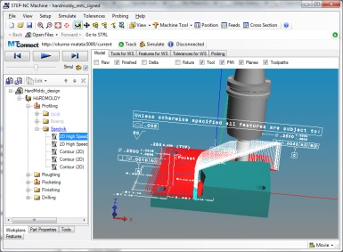
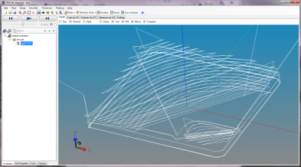
The RPI experiment
https://github.com/ghemingway/cad.js/
Digital manufacturing web server
Upload models of product and process
Simulate machining
Reverse engineer the part
JSON/WebGL
Live
observation
3D Models from CAD
Digital Manufacturing Server
STL/AP242
MTconnect data streams from industry
Snapshot
validation
XML
XML
XML
Machine
Machine
Machine
Watervliet
A.N.Other Inc.
RPI MILL

Slide 2
Mapping to JSON
Static objects
Workplan tree
Workpiece
Cutting tool
Toolpath
Technology
Shape Geometry
Path Geometry
Machine
Annotation
Dynamic objects
Tool tip location
Workpiece location
Program location
Geometry snapshot
Geometry delta

