Slide 1
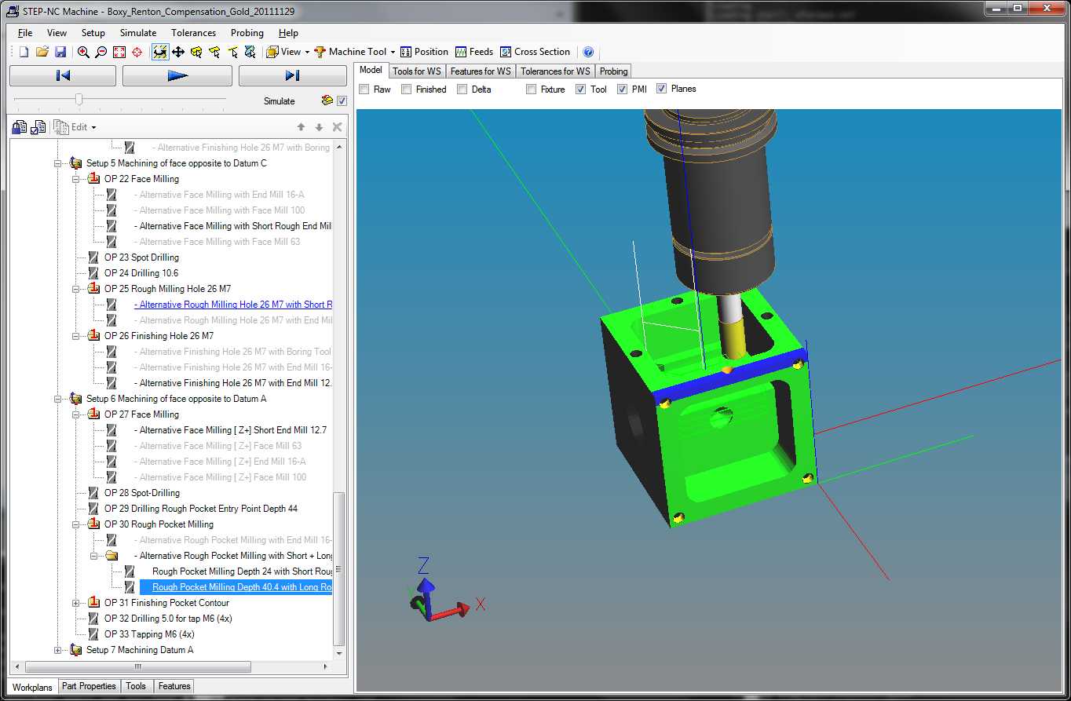
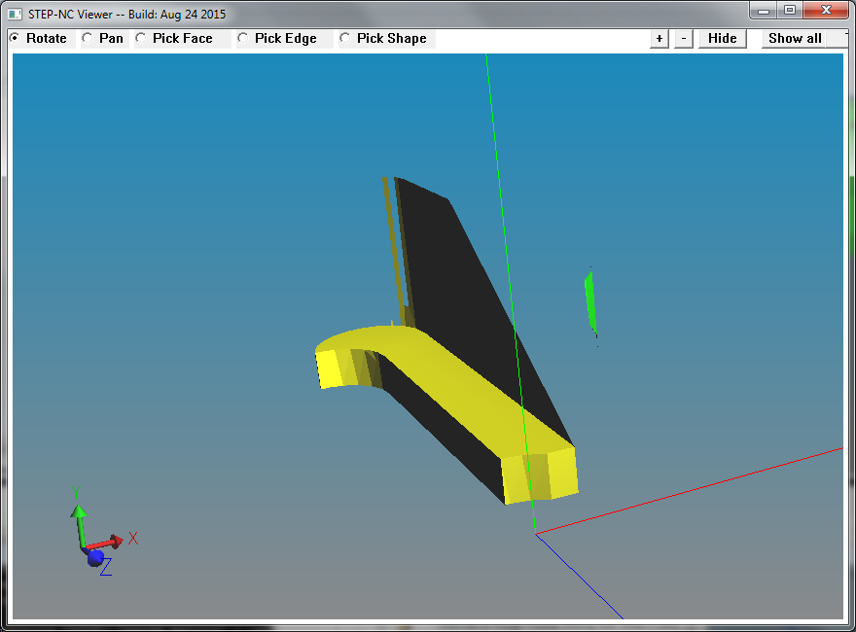
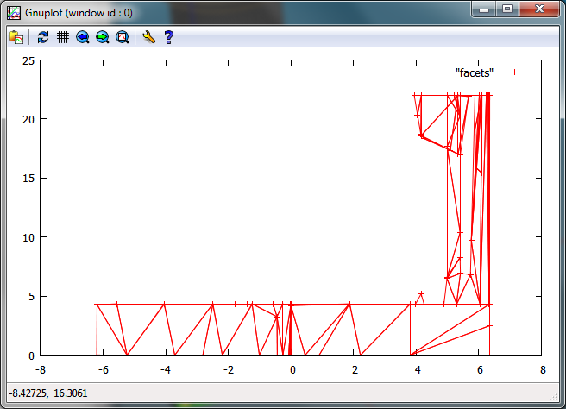
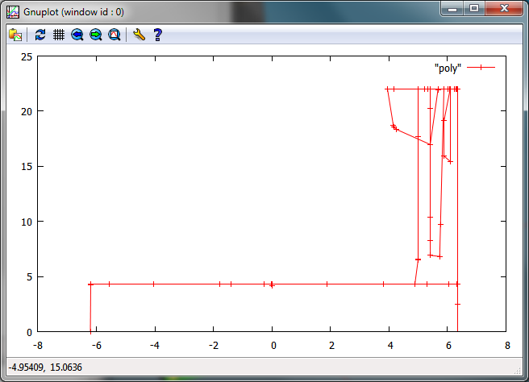
(a) Volume removal operation
(b) Volume removed (3D)
(c) Volume removed (2D)
(d) Consolidated 2D volume (incomplete)

