Slide 1
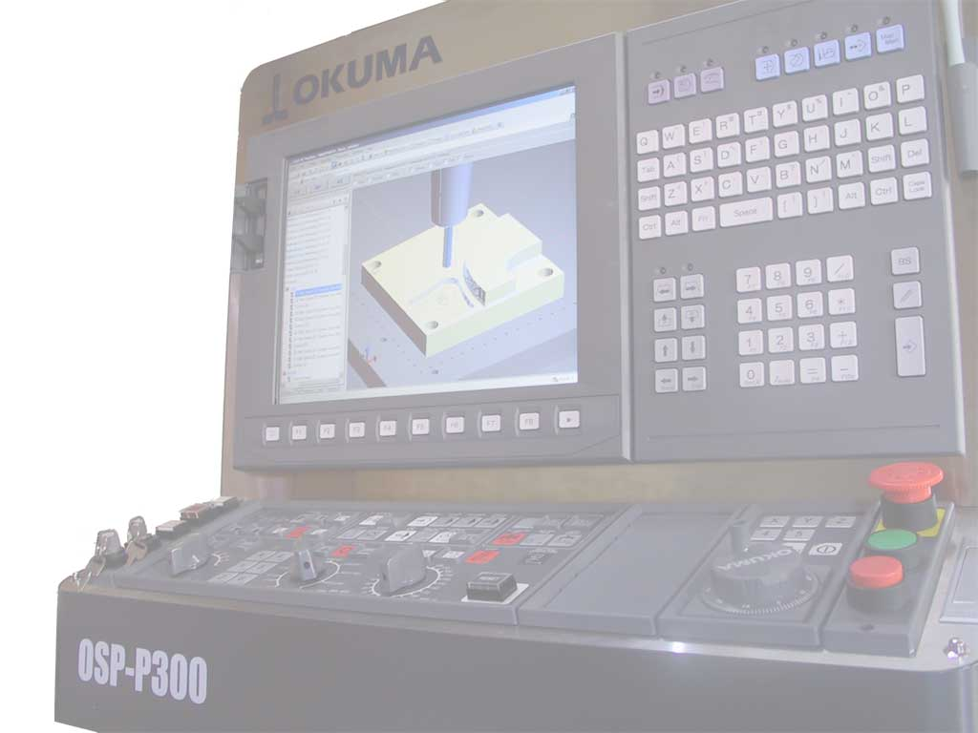
Digital Manufacturing
STEP Model
MTConnect Stream
Martin Hardwick
Professor of Computer Science, RPI
President STEP Tools, Inc.
Team Leader, ISO STEP Manufacturing
STEP Tools, Inc.
http://www.steptools.com

Slide 2
STEP-Manufacturing Roadmap
STEP 2.0 (Part 21e3)
Demonstrated (2014)
In progress (2015)
Integrated
Models
Proposed (2016)
Distributed
Models
Digital
Manufacturing
Metrology
Models
Robot
Machining
5
Flexible machines
(??% more functional)
Interoperable
Models
Remote
Operation
4
Competitive machining
(??% cost per hour)
Process
Models
Closed
Loop
3
Remote monitoring (50% less op time)
Cloud
Services
2
=> COTS translators (35% less planning)
Tooling
Optimization
1
=> Industry translators (15% faster machining)

Slide 3
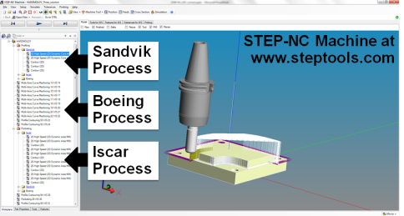
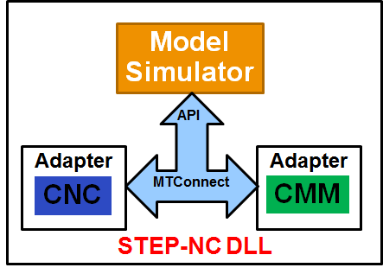
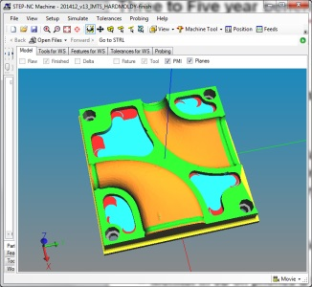
Enabling software – the STEP-NC DLL
Functions
Build models
Organize processes
Simulations
Verify kinematics
Removal material
Process in
Results out
Availability
10 years of testing
Looking for 12 partners in 2015
Interfacing
STEP in models
MTConnect out results

Slide 4
2015 - Cloud Services
NC Generation Service (Penn State)
Compute machining solution for a manufacturing stage
Input: AS-IS, TO-BE stage models and tooling selection
Output: STEP-NC process to convert AS-IS to TO-BE
3D Process Monitoring Service (Vanderbilt)
View machining results in a phone or on a table
Input: URL of machine running the process
Ouput: WebGL visualization of executing process
Tooling Optimization Service (Sandvik & Iscar)
Optimize tooling selection
Input: Current STEP-NC solution
Output: Alternate solution using better tooling
Validating usage of the STEP-NC DLL

