Slide 1
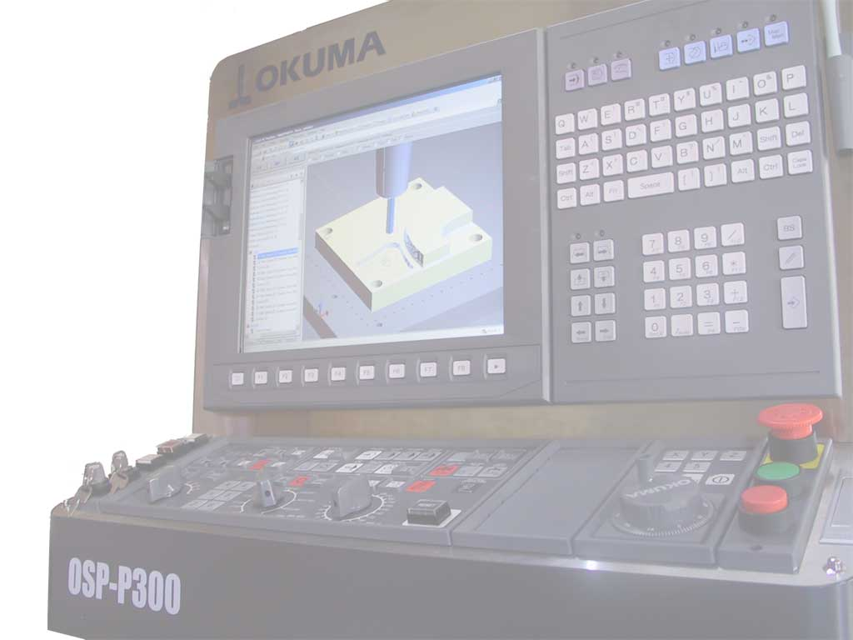
Enabling the Advanced Manufacturing Environment
Martin Hardwick
Professor of Computer Science, RPI
President STEP Tools, Inc.
Team Leader, ISO STEP Manufacturing
STEP Tools, Inc.
http://www.steptools.com

Slide 2
The advanced manufacturing problem
Solutions are machine and plant specific
Machining programs are for one CNC and cannot be reused
Drawings are hard to read and cannot be verified for completeness
Solutions must be programmed in CAM, tested on the CNC and validated in CMM
It takes a long time and the results are variable
Wait for operator to be ready
Enter model and most of drawing
Wait for CAM and CNC operators
Find the big errors
Wait for CAM and CMM operators
Check basic dimensions
1st draft CAM
1st draft CNC
1st draft CMM
Enter rest of drawing
Create operations
Wait for right tooling
Machine first part in wax
Discover critical features
Measure critical features
2nd draft CAM
2nd draft CNC
2nd draft CMM
Enter constraints not on drawing
Generate NC programs
Wait for necessary fixtures
Machine first part in material
Discover additional features
Verify part is correct
3rd draft CAM
3rd draft CNC
3rd draft CMM
No time for robots and other automation
Does it fit?

Slide 3
Model Based Manufacturing solution
Models and processes are reused across enterprises
Select best available machine
Verify tooling and fixtures are compatible
Optimize and/or edit using cloud services
Measure continued conformance of final result
Integrate robots using models
Select best available machine
Machine first part in material
Measure the model
1st draft CAM
1st draft CNC
1st draft CMM
Robots combine new paths with existing automation
It continues to fit!

Slide 4
Enabling model based manufacturing
Divide the manufacturing into stage models
Each model has defined input and output requirements
Each stage has a machine independent solution
Each stage uses robot loaders and measurement devices
Design/Choose manufacturing solution
Business Process Modeling Notation
Desired stages for the requested manufacturing task
Inputs, outputs and operations described as process flow
High level description, mostly graphical, but also formal
BPMN
Design/Choose operation solution
Process solution for a manufacturing stage
Product models for input and output, tooling and fixtures
Operations defined in context to enable 3rd party optimization
Machine independent but verifiable using CMM
STEP
Record results
Execution results for business analysis
Detailed output steam of executed actions
Feed back to update current state of stage model
Feed forward for analysis by business systems
MTConnect

Slide 5
Advanced Manufacturing Environment
Digital Infrastructure = UUID anchors, URL references, PPK signatures and fingerprints
Cloud Services
“PMI for model based manufacturing”
Model
Question
Enhanced
Model
From BPMN
Process Flow
To BPMN
Process Flow
Stage
Model
Stage Model
Processor
Stage
Model
Model
Input
Model
Results
MTConnect
From
CAD/CAM and CAx
To
Big data analysis
Adapter
Adapter
Adapter
RBT
CNC
CMM
Coordinates for placement
Motions for precision
Tolerances for validation
Model driven, coordinated motion with tolerance evaluation at key manufacturing stages

Slide 6
Key points
Input is stage models
Models previously developed for this task
PMI for intelligent machining
The required geometry, dimensions and tolerances
Cloud services for optimization
Rapid, inexpensive customization of previous solutions
Stage Model Processor
Feeds codes, coordinates and PMI to the adaptors
Prevents system collisions, monitors process conformance
Information Infrastructure
UUID anchors to enable sharing with MTConnect and BPMN
URL references to enable reuse across stages and assemblies
Signatures to verify provenance and approval

Slide 7
Development Tasks
Task 1 – Stage Model Processing
Process selection and solution generation
Real time simulation for coordination and validation
Task 2 – CNC Adaptor
Volume removal and addition by precision machines
Code generators with adaptive feedback
Task 3 – CMM Adaptor
Model validation by measurement machines
AP242 with PMI reader for ACIS
Task 4 – Robot Adaptor
Product placement by learned path machines
Coordinate generation and coordination
Task 5 – Digital Infrastructure
GD&T data sharing across manufacturing assemblies and stages
Integrity and authorization using signatures and fingerprints
Task 6 – MTConnect Modeling
Schemas for communicating stage, process and machine models
Protocols for coordination using execution results

Slide 8
Demonstration scenario
Selected products and processes for demonstration?
6 month proof of concept
12 month feasibility testing
18 month demonstration

Slide 9
Summary
The AME will be:
More automated because machines and robots will be coordinated
More reliable because processes will be monitored and measured
More flexible because processes will be machine independent
More efficient because processes will be reused not redesigned
More optimal because cloud services will customize
More secure because data will be checked using signatures
More scalable because models will be shared and reused

