Slide 1
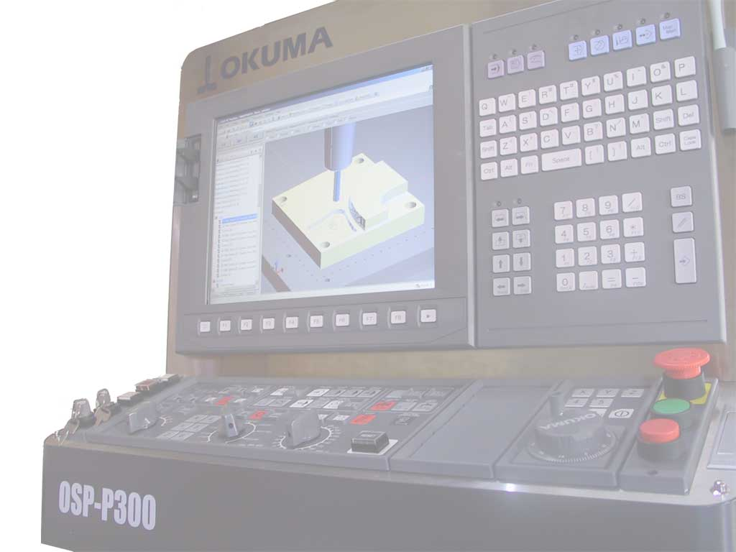
Cycle 5
Martin Hardwick
Professor of Computer Science, RPI
President STEP Tools, Inc.
Team Leader, ISO STEP Manufacturing
STEP Tools, Inc.
http://www.steptools.com

Slide 2
Objectives
CAM to CAM data exchange
Direct machining from models
Machining Cloud
Data exchange
Machining
Toolkit
codes
codes
http request
Or API request
XML
or
API
data
Adapter
Adapter
CNC
CMM

Slide 3
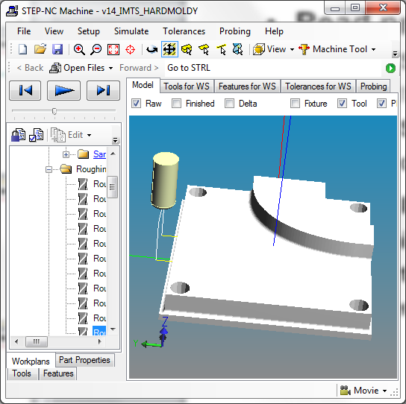
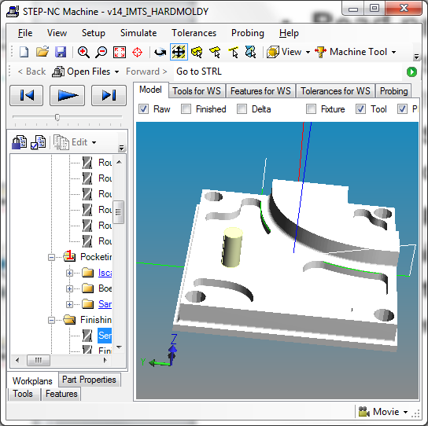
CAM to CAM Data Exchange
Read data for three processes
Read STEP for AS-IS and TO-BE geometries
Read ISO 13399 for the tools
Read STEP-NC for the toolpaths
Read depth of cut and overcut
Create new process data using CAM
Optimize process data for new machine
Export STEP-NC for new toolpaths
Deliver to direct machining team for testing
Baseline
Process
Boeing, Iscar and Sandvik
Preferred
CAM
Change paths, feeds and speed
Optimized
Process
New STEP-NC model
Adapted
CNC
Machine Moldy

Slide 4
Direct machining tool kit
New feature of the STEP-NC DLL
http://www.steptools.com/support/stepnc_docs/stepncdll/
API to read current X, Y and Z out of control
Public Function IsConnected() As Boolean
Public Function GetActualProgramX() As Double
Public Function GetActualProgramY() As Double
Public Function GetActualProgramZ() As Double
API to feed codes into the control
Public Sub SetCurrentProgram(path As String)

Slide 5
Schedule
Week 0 – Kickoff
CAM: CAM to CAM team participants
CNC: Machining team participants
Week 2 – Review technical data packages
CAM: Data for three IMTS processes
CNC: Example toolkit programs
Week 4 – Initial testing
CAM: Read STEP geometry
CNC: Air mill first IMTS process
Week 6 – Round 1 testing
CAM: Read tool geometry
CNC: Air mill three IMTS processes
Week 8 – Round 2 testing
CAM: Generate new tool paths in CAM
CNC: Wax mill IMTS process
Week 10 – Round 3 testing
CAM: Write new tool paths
CNC: Air/Wax mill process as modified in CAM
Week 12 – Round 4 testing
CAM: Read data for modified process into CAM
CNC: Machine using new CAM process
Baseline
Process
Boeing, Iscar and Sandvik
Preferred
CAM
Change paths, feeds and speed
Optimized
Process
New STEP-NC model
Adapted
CNC
Machine Moldy

